Slide 1
Lecture 1 – Introduction
Digital Multimedia, 2nd edition
Nigel Chapman & Jenny Chapman
Chapter 1

Slide 2
Digital Multimedia
The same story, information, etc can be represented in different media
Text, images, sound, moving pictures
All media can be represented digitally as a structured collection of bits
Manipulated by programs, stored, transmitted over networks
Digital media can be combined into multimedia

Slide 3
Interactive Multimedia
Combination of media is actually commonplace (e.g. TV news) and natural – we perceive the world through all our senses at once
Novelty of digital multimedia is that all media can be treated as data
Programs can manipulate data in response to user input, so digital multimedia can be interactive

Slide 4
Historical Context
Some dates:
CD-ROM specification published 1985
CD-ROM drives on desktop machines from ~1989
WWW publicly available at start of 1992
Handful of servers; line-based browser
HTML 3.2 adopted as W3C Recommendation in January 1997
Audio and video proprietary extensions

Slide 5
Cultural Development
Takes time for conventions about content and consumption to become established – cf film:
1895 footage of train arriving at station
Early animations and trick films shown as part of vaudeville acts at the same time as narrative films were being shown in cinema
Established forms translated into new medium (e.g. newsreels based on newspapers)

Slide 6
Terminology
Multimedia production – display and presentation is the sole purpose
Multimedia application – display is driven by computation
e.g. Web application presenting data stored in a database
Multiple media – user must switch between modalities (read, watch, listen,…) instead of combining them

Slide 7
Definition
Digital multimedia: any combination of two or more media, represented in a digital form, sufficiently well integrated to be presented via a single interface, or manipulated by a single computer program

Slide 8
Delivery
Online
Uses a network (usually the Internet) to send information from one computer to another
World Wide Web is commonest form of online delivery of multimedia
Offline
Removable storage medium is used to carry the data
CD-ROM, DVD

Slide 9
Page-Based Multimedia
Text, images laid out in 2-D arrangement as in book or magazine
Time-based elements embedded as if they were images
Playback controls may be provided
Pages combined using links (hypermedia)
Essentially static

Slide 10
Time-Based Multimedia
Elements arranged in time
Presented in sequence on a timeline
Elements may be frames or discrete pages (slideshow)
Often incorporates parallelism
Parallel elements may be synchronized

Slide 11
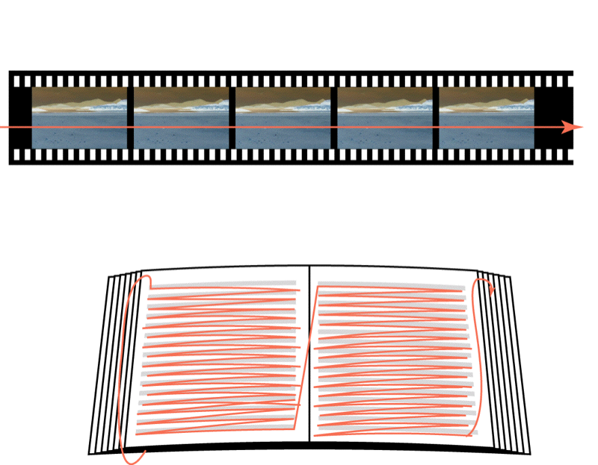
Linearity
Film: fixed order of frames defines a single playback sequence
Book: physical arrangement of text and pages implies a linear reading order

Slide 12
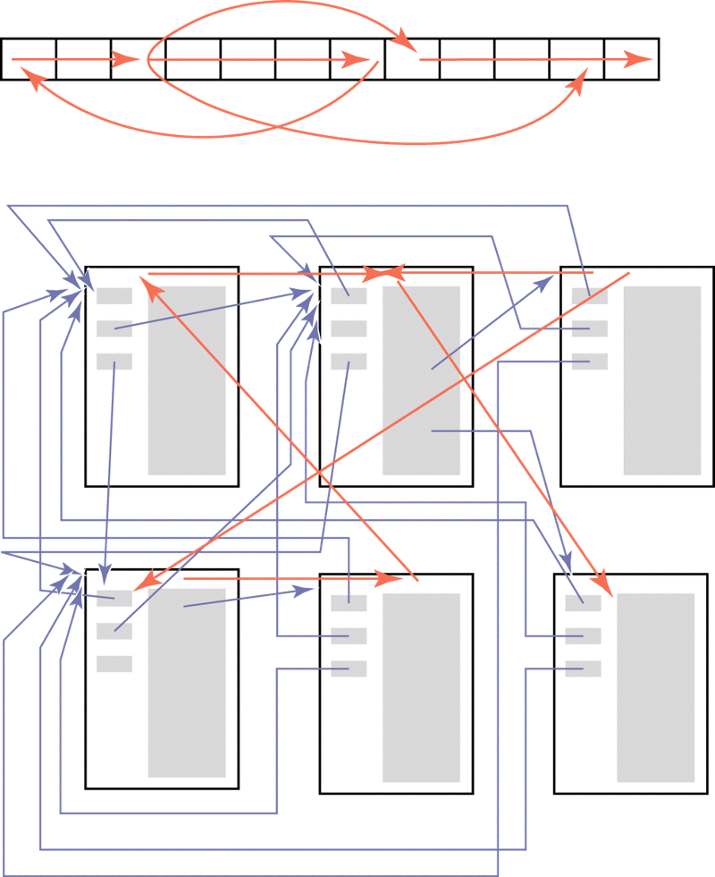
Non-Linearity
Flash: jumps between frames, controlled by interactivity, permit branching and loops
Hypermedia: links between pages permit multiple arbitrary reading orders

Slide 13
Interactivity
User input may control a multimedia production, but only within limits set by the multimedia producer
Only choices that are coded into the program are possible
Can allow the user to control events at many points, leading to combinatorial growth in number of possibilities
e.g. 4 choices at each of 5 points implies 20 branches but 1024 possible sequences

Slide 14
User Interfaces
Means of presenting choices and accepting user input can vary enormously from
Stylized interface elements used by mainstream OSs and applications
to
Free-form, dynamically changing interaction of games
Conventions are predictable, but limited to (static) context in which they were developed

Slide 15
Access
If access to multimedia is the norm, those denied access become marginalized ('digital divide')
Access may be limited by lack of:
Access to equipment and skills
Network infrastructure
Literacy and education
Physical and cognitive abilities
These factors may depend on wealth, geographical location,…

Slide 16
Traditional Media Production
Access to production of traditional media highly restricted
Books: distributed through publishers, subject to editorial scrutiny; barriers to newcomers
Film: very high cost; studios prefer safe bets
Music: mostly distributed by few labels controlled by small number of multinationals; hard to break in to the business
TV: video production relatively low cost, but access to broadcast rigidly controlled

Slide 17
Web Site Production
Potentially anyone with Internet access can have their own Web site
ISPs provide free Web space
Free and inexpensive tools are adequate
WWW has potential for revolution in access to the means of production and distribution of digital material

Slide 18
Control of Content
All sufficiently complex societies seek to control what people may see or hear, either by explicit policing, economic or other means
Rapid growth of the Internet and its potential for disseminating unacceptable content has given new impetus to debates about censorship
Complicated ethical issues with no enduring conclusion or consensus despite thousands of years of debate

Slide 19
Diversity
WWW is global network, hence material reaches many different societies and cultural and religious groups within those societies
Many different models of censorship – none, rigid centralized control, self-regulation, …
Unrealistic to expect a single model of censorship to be acceptable everywhere
Difficult to assign responsibility for disseminaton of content on Internet

Slide 20
PICS
Platform for Internet Content Selection
Attempt to provide a mechanism that supports a diversity of attitudes towards content and censorship
Labels attached to each page, providing a rating of its contents
PICS only defines standard label format
Screening software rejects material deemed unsuitable according to user's criteria
Defers the difficult decisions

