Slide 1
Lecture 2 – Digital Representations
Digital Multimedia, 2nd edition
Nigel Chapman & Jenny Chapman
Chapter 2

Slide 2
Bits and Bytes
Devices can only be in one of two states
0 or 1, yes or no, on or off, …
Bit: a unit of data that can only have one of two values
Byte: an ordered sequence of eight bits
Word: a short sequence of bytes, usually four (32 bits)

Slide 3
Interpretation of Bits
Numbers to base 2 (binary)
01100001 = 97 decimal
Characters – associate bit patterns (numbers) with characters via a character set
01100001 = a in ASCII
Brightness of an image at a point, instantaneous amplitude of a sound wave, etc

Slide 4
Addresses
Each byte can be identified by its position in the sequence of all bytes in memory – its address
Collections of bytes can be combined into data structures using addresses
e.g. store an image as a sequence of brightness values, use address of the first to access the image data
store a video sequence as series of images, add address of next and previous to each frame

Slide 5
Instructions
Bit patterns that cause the processor to carry out operations on values stored in memory
Hardware is constructed so that the desired effect is achieved
Programs stored in memory as a sequence of instructions to be executed in order
A computer is a stored program machine
It can therefore be used for many different tasks, depending on the programs it runs

Slide 6
Digitization
Converting a signal from analogue to digital form
Analogue signal can vary continuously, digital is restricted to discrete values
Two-stage process
Sampling – measure the value at discrete intervals
Quantization – restrict the value to a fixed set of quantization levels

Slide 7
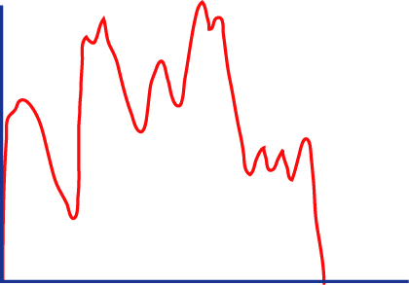
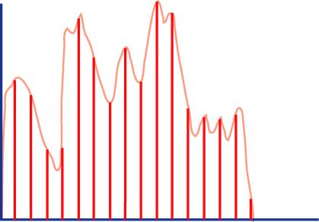
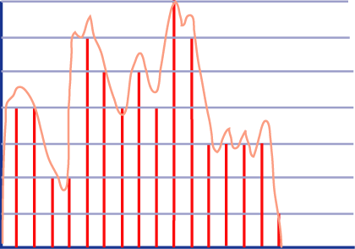
Sampling and Quantization

Slide 8
Digital Signals
Only certain signal values are valid
Relatively immune to corruption by noise
Do not degrade when copied or transmitted over network
Some information lost
Undersampling
Samples 'too far apart' so cannot accurately reconstruct original signal

Slide 9
Frequency Domain
Any periodic waveform can be decomposed into a collection of frequency components
Each one is a pure sine wave
The collection of frequencies and their amplitudes represent the waveform in the frequency domain
Compute the frequency domain representation (frequency spectrum) using the Fourier Transform
Higher frequency components are associated with abrupt transitions

Slide 10
Sampling Theorem
If the highest frequency component of a signal is at fh the signal can be properly reconstructed if it has been sampled at a frequency > 2fh
Nyquist rate
Undersamping leads to aliasing
Sound distortion, image 'jaggies' or Moiré patterns, jerky or retrograde motion

Slide 11
Too Few Quantization Levels
Reducing memory requirements by using fewer bits for each value means fewer quantization levels are available
Cannot distinguish between values that fall between levels
Images: banding and posterization
Sound: coarse hiss, loss of quiet passages, general fuzziness (quantization noise)

