Slide 1
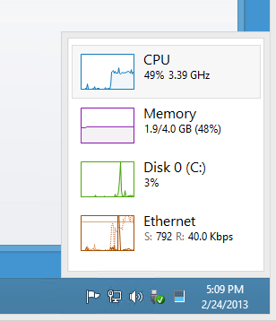
CHAPTER 8
Managing Software and System Resources

Slide 2
Soft wares can be installed by two different methods
RPM (Red Hat Package Manager) ext .rmp e.g soundcardV88.rpm
(The display of .rpm files are black or white color)
Source files ext .tar e.g driver-0.5.tar
(the display of .tar files are always in red color)
To configure a source file follow the below steps
./configure ; make ; make install

Slide 3
RedHat Package Management (RPM)
RPM was first used with Red Hat Linux in 1995.
First time it was written in pearl and then rewritten
in C for Red Hat 3.0.3 in 1996.
Using options/switch/flags with rpm command:
1- install (-i)
2- delete (-e),
3- upgrade (-U)
4- verify (-V)
5- query (-q).
Three parts of RPM
Signature (Containing the authentication that this package is genuine)
Mathematical code (The actual coding of the rpm)
Archives (It holds the actual files that comprises the package in compressed format)

Slide 4
RedHat Package Management (RPM)
Installing a new package by rpm
# rpm –ivh pine-4.44-7.i386.rpm
Preparing… ############## [100%]
1.pine ############## [100%]
Verify a installed package by rpm
# rpm –V pine
Query a installed package by rpm
# rpm –q pine
Upgrade an installed package by rpm
# rpm –Uvh pine.-4.48.8.i386.rpm
Preparing… ############## [100%]
1.pine ############## [100%]

Slide 5
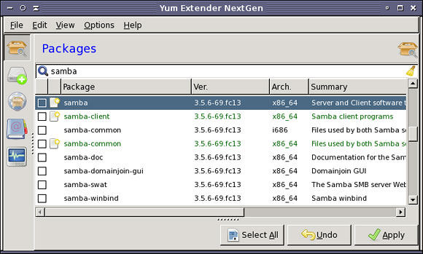
RedHat Package Management (RPM)
Remove a package by rpm
# rpm –e pine
Extracting and looking into a rpm file
# rpm –q --pine.43.rpm > scripts.txt
Graphical Package Management
On your desktop select :
Start -> System Setting -> Packages .

Slide 6
Tar file
Extracting a Tarred file and modifying in an editor
# tar -xjvf freetype-2.0.9.tar.bz2 (fonts file)
# cd freetype-2.0.9
# vi freetype/config/ftoption.h
# tar cfj freetype- 2.0.9.tar.bz2 freetype-2.0.9
# rpmbuild –bb freetype.spec (during the build process press ‘y’ if asked)
After it is build a new rpm will be stored in /usr/src/redhat/RPMS/i386
.
.
.
#undef TT_CONFIG_OPTION_BYTECODE_INTERPRETER
#define TT_CONFIG_OPTION_BYTECODE_INTERPRETER
(modified)
.
.
:wq!

Slide 7
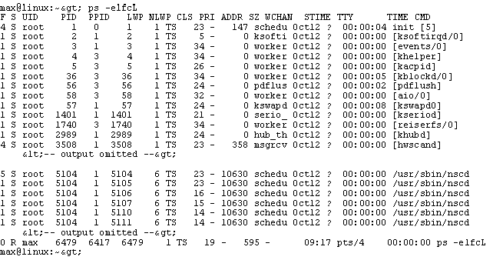
Process id + name for every command during execution
To view a process
# ps
PID TTY TIME CMD
tty1 00:00:00 tree
tty2 00:00:01 bash
tty1 00:00:09 vi
# ps –aux

Slide 8
Process id + name for every command during execution
To view a process by its id number
# ps 738
PID TTY TIME CMD
tty1 00:00:00 tree
To Terminate a process
# kill 738
[1]+ Terminated tree
To Terminate a process forcefully
# kill -9 738
[1]+ Terminated tree
PID
The terminating options start from 1 - 9 .

Slide 9
Changing the Priority of a Command
# nice
# nice -n 0 ls –la (The command will be brought to high priority and will be
executed before the other commands which are in a queue)
# nice -n 20 date (the command will be brought to a low priority and will be
executed after all the other commands which are in a queue)
0 1 2 3 4 5 6 7 8 9 10 11 12 13 14 15 16 17 18 19 20

Slide 10
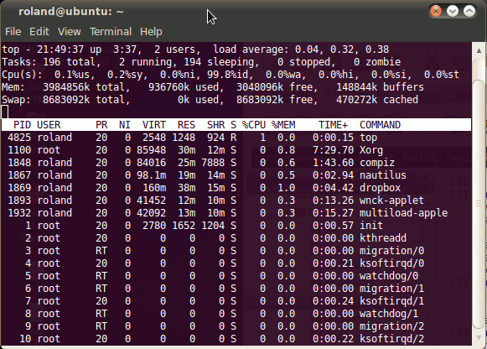
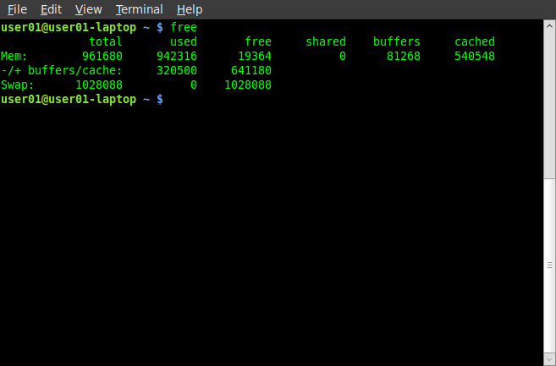
Some more important commands of the chapter
# top (displays the on going programs on the system , refreshed the screen after every 5sec.)
# free (it will display the used and free disk space of the system )

Slide 11
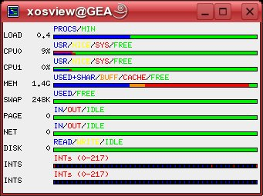
Graphical Process and System Management Tools
# xosview –geometry 406*488 -font 8*16 +load +cpu +__ +__ +__ +__...
(displays the real time load chart of the system )
Some more graphical system and process monitoring tools
vncviewer 5. ktimemon 9. kcron
nmapfe 6. kdf
ethereal 7. kisdndock
gnome-system-monitor 8. ksysguard

