Slide 1
Chapter 7 File and file System structure

Slide 2
UNIX File System
/
|--bin
|--boot
|--dev
|--etc
|--home
| |--bilal
| |--abid
| | |--myfolder
| |--usman
|--misc
|--lost+found
|--mnt
|--opt
|--root
|--sbin
|--usr

Slide 3
Directory structure
/ “native root” – It is the main directory in which all the rest UNIX directories are located
/bin -It requires about 550mb of space, contain essential commands used by the system
when running and booting UNIX.
/sbin -It requires about 550mb of space, contain essential commands used by the system
when running and booting UNIX.
/boot -It contains UNIX kernel which is loaded at boot time.It also contain files that contain
information for booting Linux.
/dev -It contains 7500 files representing devices.
/etc -It contains more then 20mb system configuration files and directories .Containing
some major software packages like apache , Openssh and passwd file.
/home -It contains the directories of all the normal users, when ever a new user is created
then automatically a directory will be created by his/her name inside home directory.
when ever a user will login then he/she will automatically will jump in his/her home
directory.
/proc -It only exist while UNIX is running and it shows different memory usage.
/usr -It is approx 5GB in size and contains software applications and libraries.
/tmp -it is used for temporaty file storage.The tmp directory is cleaned of each day and will
delete files that are not used for 10 days.
/var -It contains directories and sub directories used by various system services e.g mail ,
ftp etc…

Slide 4
Types of Files -simple/ordinary files ------simple text files -directory ------contain more directories and files -symbolic (soft) links ------Active duplicate links -special files ------Hardware files -named pipe and socket ------network related files

Slide 5
Some basic commands
List down files and directories
ls =list down all the files and directories.
ls –a =It will list down all hidden the files and directories
ls –la =It will list down all hidden the files and directories in detail
bin dev home lib etc myfilea mYfilea myFilea
mnt usr myhomedirbk17oct2013.tar
.profile .login bin dev home lib etc myfilea mYfilea myFilea
mnt usr myhomedirbk17oct2013.tar
-rwxrwxrw- 1 root root 5 aug 2008 17:34 654 .profile
drwxrw-rw- 2 root root 8 aug 2010 12:34 598 bin
-r—r—r-- 1 usman ali 14 sep 2005 05:12 746 Myfilea

Slide 6
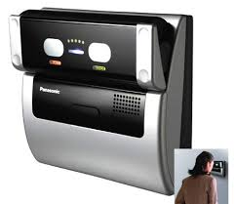
eye-node i - node number
Unique number for each directory and file
The human retina is a thin tissue composed of neural cells that is located in the posterior portion of the eye. Because of the complex structure of the capillaries that supply the retina with blood, each person's retina is unique.
ls -i =list down all the files and directories with .
i-node number .
7874 bin 8932 home 47334 myFilea

Slide 7
Commands
Creating files and directories+ special characters
rm file* -It will remove all the files starting from the name file no matter
how lengthy there name is, will remove file1, file111, fileabc43er, fileg
* is a meta character which has a special meaning behind it (meaning every
thing)
rm file? -It will remove all the files starting from the name file and just one more
extra character in the name, will remove file1, fileB, filec, file8.
? again is a meta character which has a special meaning behind it (meaning
just one character or letter), it acts like a fill in the blank
rmdir -p Spring/junedirectory
-it will delete two directories , a parent directory by the name
Spring and a subdirectory by the name junedirectory .
rmdir -to remove a directory
mkdir -It will create a directory ,e.g mkdir mydir32
mkdir -p Spring/junedirectory
-it will create two directories , a parent directory by the name
Spring and a subdirectory by the name junedirectory

Slide 8
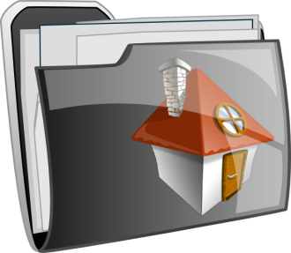
Commands
Back to user Home directory
When ever a new user is created, UNIX will automatically create a
folder by exact user name on the path /home
cd -To move and to go into the home directory of a user. If user usman
is on the path /home/ali and he want to go to his home directory which
will be /home/usman then he will type the command cd
cd $HOME -To move and to go into the home directory of a user. If user usman
ls $HOME is on the path /home/ali and he want to go to his home directory which
echo $HOME will be /home/usman then he will type the command cd $HOME
By ls $HOME command it will list down file and directories of your home direcroty cd ~ -To move and to go into the home directory of a user. If user usman
is on the path /home/ali and he want to go to his home directory which
will be /home/usman then he will type the command cd ~
cd .. -it will go one step back. Moving back one step in the directory structure.
pwd -it will show and print on the screen your present working directory path.
meaning where you are your current position in the directory structure.

Slide 9
Commands
ls -F / -It will display all the files and directories, a special letter representing
its type of file will be displayed on extreme right hand side, e.g bin/
dev/ install@ unix* .(directory “/” ,link file “@” and executable “*” )
Standard files and File Descriptors
stdin standard input device file <
stdout standard output device file >
stderr standard error message device file 2>

Slide 10
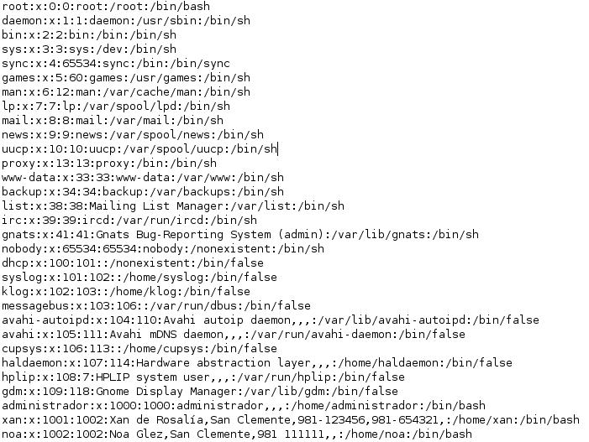
Linux users
The files which keeps the information of users
The passwd file: (etc/passwd) old method file
User name
Password
User id
Group id
User description
User home directory
User shell

Slide 11
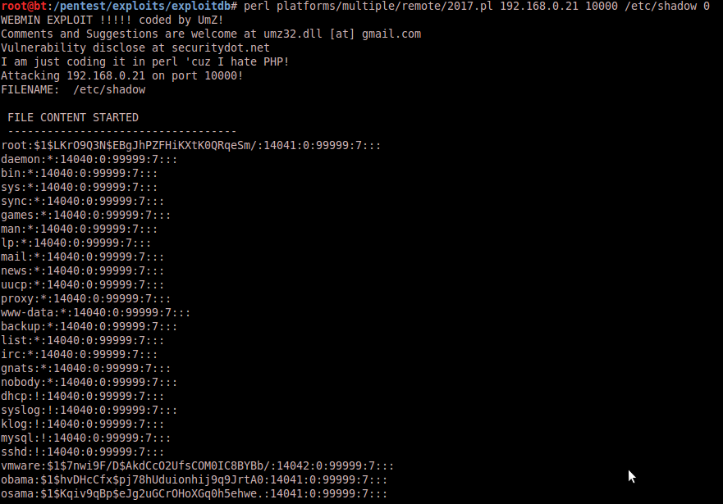
Linux users
The files which keeps the information of users
The shadow file: (etc/shadow) new method file , most information is encrypted
User name
Password
User id
Group id
User description
User home dir
User shell

Slide 12
Chapter 8 File Security

Slide 13
Security measures
User and password confidential
File to be encrypted
Give privileges and restrict users

Slide 14
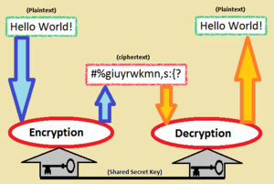
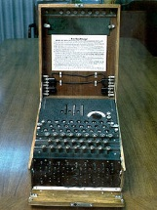
Encryption- Base protection

Slide 15
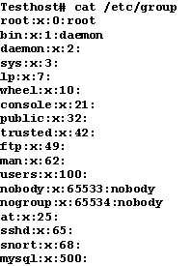
Group Information File
The files which keeps the information of group
The group file: (etc/group)
group name
Password
Group id
more etc/group

Slide 16
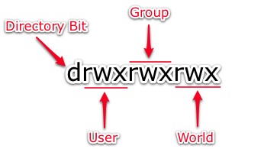
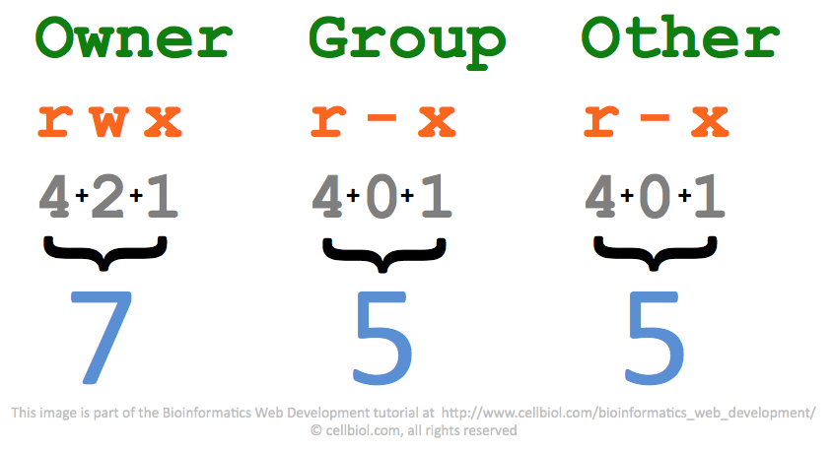
File permissions

Slide 17
File permissions
Giving file permissions to files and directories
chmod 777 myfile Will assign read, write and execute permissions to
all owner, group and others (rwxrwxrwx)
chmod a+rwx myfile will assing read, write and execute permissions to
all owner, group and others (rwxrwxrwx)
chmod g-rx myfile will retrieve write permissions from group(rwx-w-rwx
chmod -R 644 root will assign read and write permissions to owner and read
permissions to group and others , this permission will be
effected on the directory as well as all the subdirectories
and folders residing inside root (rw--r--)
chmod 7 courses full permissions will be assigned to other user.
chmod 70 courses full permissions will be assigned to group
chmod 700 courses full permissions will be assigned to owner
Command -option argument description

Slide 18
The UNIX Gangster umask
0 2 2
Directories 777
Umark -022
Left out 755
Files 666
Umark -022
Left out 644
To check umask powers, just type umask in your shell
# umark
022

Slide 19
The UNIX Gangster umask
Increasing the powers of umask
# umask 444
Directories 777
Umark -444
Left out 333
Files 666
Umark -444
Left out 222

Slide 20
Special access bits
chmod 4710 myfile Will assign special permissions to owner
# ls –l myfile
-rws--x--- 1 ali faculty 12 may 09:35 myfile
chmod u+s myfile Will also assign special permissions to owner
# ls –l myfile
-rwS-x--- 1 ali faculty 12 may 09:35 myfile
chmod u-s myfile Will role back special permissions from owner
# ls –l myfile
-rw--x--- 1 ali faculty 12 may 09:35 myfile
Set-User-ID (SUID) Bit

Slide 21
Special access bits
chmod 2741 myfile Will assign special permissions to group
# ls –l myfile
-rwxr-s--x 1 ali faculty 12 may 09:35 myfile
chmod g+s myfile Will also assign special permissions to group
# ls –l myfile
-rwxr-S--x 1 ali faculty 12 may 09:35 myfile
chmod g-s myfile Will role back special permissions from group
# ls –l myfile
-rwxr----x 1 ali faculty 12 may 09:35 myfile
Set-Group-ID (SGID) Bit

Slide 22
Special access bits
chmod 1741 myfile Will assign special permissions to other user
# ls –l myfile
-rwxr----t 1 ali faculty 12 may 09:35 myfile
chmod +t myfile Will also assign special permissions to other user
# ls –l myfile
-rwxr----T 1 ali faculty 12 may 09:35 myfile
chmod -t myfile Will role back special permissions from other user
# ls –l myfile
-rwxr----x 1 ali faculty 12 may 09:35 myfile
Sticky Bit

