Slide 1
Chapter 6
The X Window System

Slide 2
X window system or x11r6, x11, x (1980’s)
current version 4.2.1 (xfree86)
server
more then 24 rpm’s available
directories that contain information of xfree86
/use/x11r6/bin
/use/x11r6/include
/use/x11r6/lib
/use/x11r6/lib/x11
/use/x11r6/lib/modules
/use/x11r6/man
Client
x
Client
x
Client
x
Client
x

Slide 3
Elements of xf86config file
The configuration files has different sections which are listed below:
Server layout (information of the server side settings)
Files (information and path of items related to files ,e.g font, logs etc..)
Modules (list of all the modules which will be loaded and available at boot time)
Input devices (information of input devices like mouse, keyboard etc..)
Monitor (information and settings of monitor like model ,type etc)
Devices (information of smaller devices like sound card, video chip set)
Screen (information and settings of screen resolution, depth, pixel etc…)
Command to configure X Window
redhat-config-xfree86
A step by step installation method form drop down list of drivers
Refer to page 170-190

Slide 4
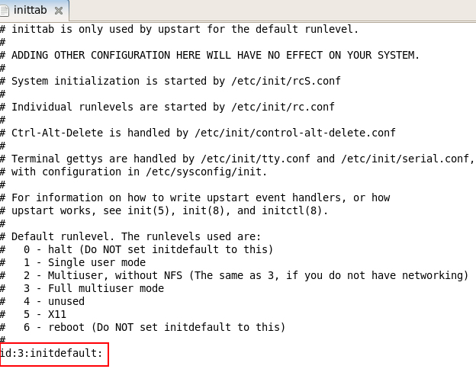
Starting X
Different modes of Linux start up (/etc/inittab)
# 0 - halt (Do NOT set initdefault to this)
# 1 - Single user mode
# 2 - Multiuser, without NFS (The same as 3, if you do not have networking)
# 3 - Full multiuser mode, multi user mode with text base
# 4 – unused, your own custom base
# 5 - X11, multiuser mode with GUI
# 6 - reboot (Do NOT set initdefault to this)

Slide 5
Starting X
Setting your default GUI (/etc/sysconfig/desktop)
DESKTOP= GNOME
or
DESKTOP= KDE
or
DESKTOP= XDM
Configuring Gnome settings(1997)
gdmconfig &
Configuring KDE settings(1996)
su -c kcontrol
Configuring XDM or TWM settings (1988,tiling window manager)
edit a few file in the directory (/etc/xii/xdm)
Starting x in command line prompt
startx
startx – depth 16 (color depth)
startx -- -dpi 100 (dots per inch)

Slide 6
Selecting and Using X Window Manager
Setting and appearance
Controls
Features
Desktop appearance
icons
Keyboard keys function
Drag and drop….
Switching to KDE GUI mode
switchdesk KDE or switchdesk KDE &
Window managers
The tab window manager (twm)
The motif window manager (mwm)
The sawfish
The window maker window manager (wmaker)

