Slide 2
Group Members:
M. Khayam Shahzad
M. Murtaza Farrukh
Aneel Abbasi

Slide 3
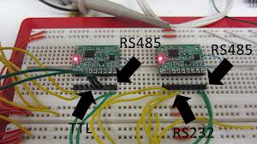
Electrical Standards & RS232

Slide 4
Introduction:
This section introduces the RS232 serial standard.
This is a standard that is used to connect serial devices like modems to the PC.
The main features and signals of the standard will be covered.

Slide 5
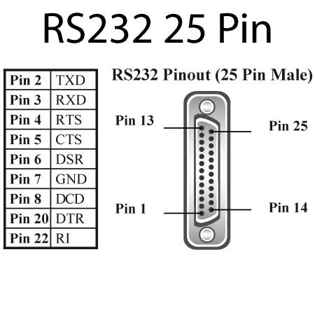
The RS232 standard:
Specifies a 25 pin connector as the standard interface in data communication networks.
Lettering pin designations for ground, data, control and timing circuit.

Slide 6
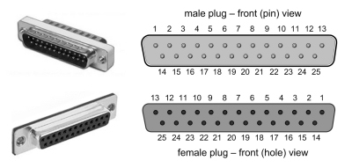
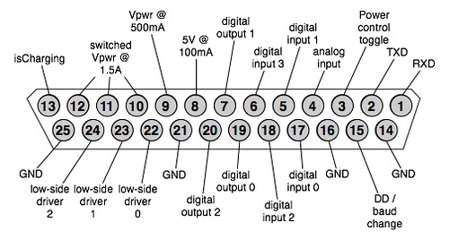
The RS232 Connector:
Two main categories:
Male connector.
Female connector.

