Slide 1
Chapter 4 Post-Installation Configuration

Slide 2
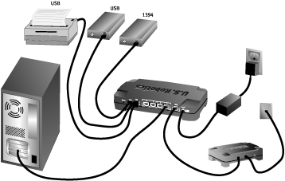
Kudzu Service
If kudzu service is enabled then Red Hat will automatically detect new hard ware upon rebooting and will install it .
Hardware setting path
The settings of all the hard wares are on the path /etc
e.g /etc/sysconfig/clock , /etc/sysconfig/harddisk ……
Installed Hardware information path
The information of all the hard wares installed on the system are on the path /dev
e.g /dev/mouse , /dev/keyboard ……
Command to see if linux has recognize the device during boot process.
The command is dmesg

Slide 3
Mouse Manual configuration
mouseconfig
redhat-config-mouse
redhat-config-mouse & (more graphical user interface)
KeyBoard manual configuration
redhat-config-keyboard & (more graphical user interface)
redhat-config-keyboard
Managing Services
ntsys
redhat-config-services
To manage and start a services at boot time
Graphic Card CONFIGURATION
xf86config
redhat-config-xfree86 (more graphical user interface)

Slide 4
Sound Card manual CONFIGURATION
redhat-config-soundcard
redhat-config-soundcard & (more graphical user interface)
if you face a problem in installing sound card then visit www.opensound.com ,
there are over 350 sound card drivers available
Newtork/ethernet Card CONFIGURATION
redhat-config-network
redhat-config-network & (more graphical user interface)
System date manual CONFIGURATION
redhat-config-date
redhat-config-date & (more graphical user interface)
hwclock - -set - -date “09/16/03 08:00:00”
hwclock - -hctosys
hwclock - - systech

Slide 5
Some useful commands of this chapter
stateserial /dev/ttySO (to know information of a specific port)
cat /home/myfile (to view a file)
date (to view system date and time)
cp (to copy a file)
System health and temperature
/usr/sbin/sensors-detect (show health of system)
sensors -f (show temperature of system in fahrenheit)
Taking backups of files and directories from time to time
cp myfile myfilebk10sep2013
cp –R mydirectory mydirectorybk10sep2013
Recursive option used for all the file and subdirectories inside a perticular directory

