Slide 1
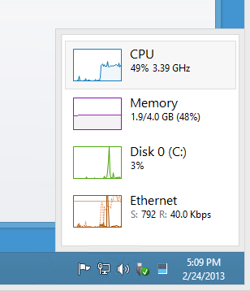
CHAPTER 13
Processes

Slide 2
Process:
A process is a program in execution . A process is created every
time you run an external command . A process is removed from the system
when command finishes its execution.
-A process is executed for a short period of time, and then the CPU is taken away
from it and given to another process.
-The Time a process is in the CPU burst before it is switched out of the CPU is called
quantum or time slice .
-The Kernel uses an algorithm to decide which process gets to use the CPU next.
the technique used to choose the process that gets to use the CPU is called CPU
scheduling .
METHODS ( FCFS,ROUND ROBIN etc……)

Slide 3
UNIX Process Status :
NORMAL: A process terminates normally when it finishes its work
and exits the system gracefully .
ABNORMAL: A process terminates abnormally when it exits the system
because of an exception, condition or intervention by its owner.
PROCESS STATES:
- Ready: A process is ready to run but does not have the CPU.
- Running: The process is actually running.
- Waiting: The process is waiting for an event.
- Swapped: The process is ready to run but it has been temporarily
put a side because it needs more memory.
- Zombie: A Dying process.

Slide 4
Internal commands:
An internal command is one whose code is part of the shell
process.
External commands:
An external command is one whose code is in a file.
Fork System
Parent and Child process:
-The very first process that executes is the parent process
- The process that execute under the parent process is a child
process ,Child process can be many .

Slide 5
Process id + name for every command during execution
To view a process
$ ps
PID TTY TIME CMD
tty2 00:00:01 bash
$ csh
% ksh
% ps
PID TTY TIME CMD
tty2 00:00:01 bash
tty2 00:00:02 csh
tty2 00:00:01 ksh
^D
^D

Slide 6
Out put with out session leader
To view a process
# ps
PID TTY TIME CMD
tty1 00:00:00 tree
tty2 00:00:01 bash
tty1 00:00:09 vi
# ps –a
PID TTY TIME CMD
tty1 00:00:00 tree
tty1 00:00:09 vi

Slide 7
Processes of a user
To view a process
# ps –u 147
UID PID TTY TIME CMD
789 tty1 00:00:00 tree
147 869 tty2 00:00:01 bash
147 658 tty1 00:00:09 vi
# ps –u Usman
OR
UID PID TTY TIME CMD
789 tty1 00:00:00 tree
147 869 tty2 00:00:01 bash
147 658 tty1 00:00:09 vi

Slide 8
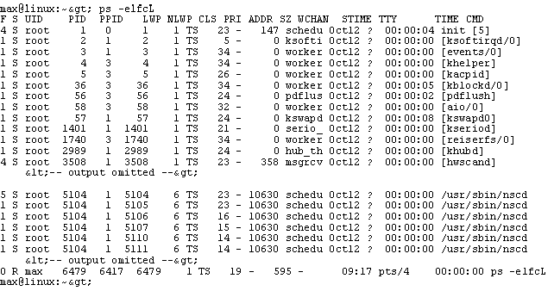
Process id + name for every command during execution
To view a process
# ps
PID TTY TIME CMD
tty1 00:00:00 tree
tty2 00:00:01 bash
tty1 00:00:09 vi
# ps –l

Slide 9
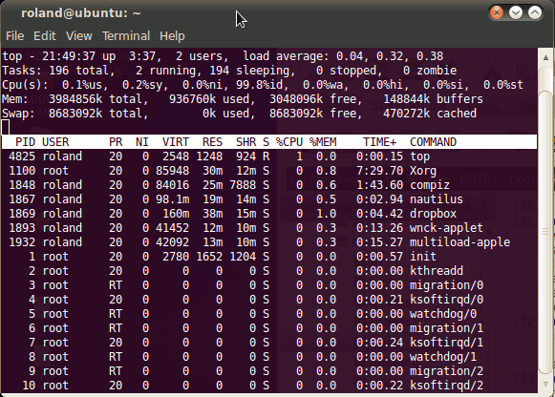
Some more important commands of the chapter
# top (displays the on going programs on the system , refreshed the screen after every 5sec.)
To exit from top press CTRL C

Slide 10
Foreground and Background Process
Foreground Process:
When a command executes in the foreground , it keeps
control of the keyboard and the display screen. find / -name docUnix -print > /home/umar/Umar.txt
Background Process:
While the command executes you gets the shall prompt
back and can do other work. find / -name docUnix -print > /home/umar/Umar.txt &
[1] 68743
Job id process id

Slide 11
Foreground and Background Process
find / -name docUnix -print > /home/umar/Umar.txt &
[1] 834
find / -name Doc545 -print > /home/ali/ali.txt &
[2] 3354
find / -name Mydoc -print > /home/usman/Usman.txt &
[3] 5837
# ps
PID TTY TIME CMD
834 pts/0 0:03 find / -name docUnix -print > /home/umar/Umar.txt &
3354 pts/0 0:11 find / -name Doc545 -print > /home/ali/ali.txt &
5837 pts/0 0:04 find / -name Mydoc -print > /home/usman/Usman.txt &

Slide 12
Changing the Foreground and Background Process
find / -name docUnix -print > /home/umar/Umar.txt
# fg
# fg %3
find / -name Mydoc -print > /home/usman/Usman.txt
# bg
find / -name docUnix -print > /home/umar/Umar.txt &
[1] 83423
# bg %2
find / -name Doc545 -print > /home/ali/ali.txt &
[2] 647
# jobs

Slide 13
Sequential and parallel execution of commands
date; echo Hello, world!
Fri Jun 18 23:42:28 PDT 2014
Hello, world!
date& echo hello, world& uname ; who
[1] 4543
[2] 5538
Hello, world!
[2] Done
Fri Jun 18 23:43:48 PDT 2014
[1] Done
Unix0s
Rashid pts/0 jun 12 13:33
Abbas pts/1 jun 18 02:55

Slide 14
Sequential and parallel execution of commands
(date; echo Hello, world!) who
Fri Jun 18 23:42:28 PDT 2014
Hello, world!
Rashid pts/0 jun 12 13:33
Abbas pts/1 jun 18 02:55
(date, echo hello, world)&
[1] 4543
Fri Jun 18 23:43:48 PDT 2014
Hello, world!
[1] Done

Slide 15
Sequential and parallel execution of commands
(date; echo Hello, world) & (who; uname)& whoami
[1] 6533
[2] 1464
Haider
Fri Jun 18 23:42:28 PDT 2014
Hello, world
[1] Done
Rashid pts/0 jun 12 13:33
Abbas pts/1 jun 18 02:55
Unixos
[2] Done

Slide 16
Process id + name for every command during execution
To view a process by its id number
# ps 738
PID TTY TIME CMD
tty1 00:00:00 tree
To Terminate a process
# kill 738
[1]+ Terminated tree
To Terminate a process forcefully
# kill -9 738
[1]+ Terminated tree
PID
The terminating options start from 1 - 9 .

Slide 17
Init process : The very first process, a process which has no parent. Process id is 1.
Getty process
Login process
User and password
Session
ptree -a hamza
/etc/init
/usr/sbin/inetd –s
-bash
sh
8975 ptree –a hamza
disPlayed With option -a

