Slide 1
Software Management Disciplines Project Organization and Responsibilities
(from Part III, Chapter 11 of Royce’ book)

Slide 2
Topics for Today
Line-Of-Business Organizations
Project Organizations
Evolution of Organizations

Slide 3
Organization
Line-of-Business
Organize for return on investment, new business discriminators, market diversification, and profitability.
Project
Organize for cost, schedule and quality of specific deliverables.
both
Organize for career growth, job satisfaction, and opportunity for employees

Slide 4
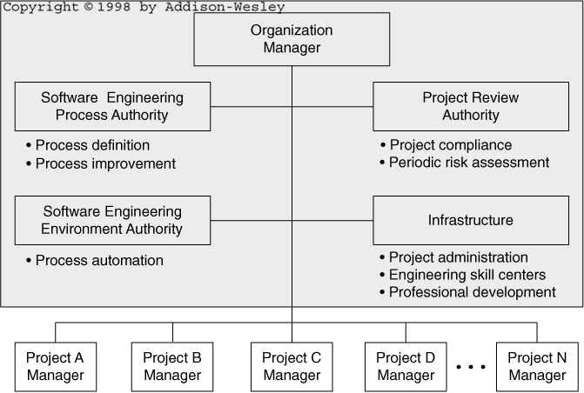
Line of-Business Organization

Slide 5
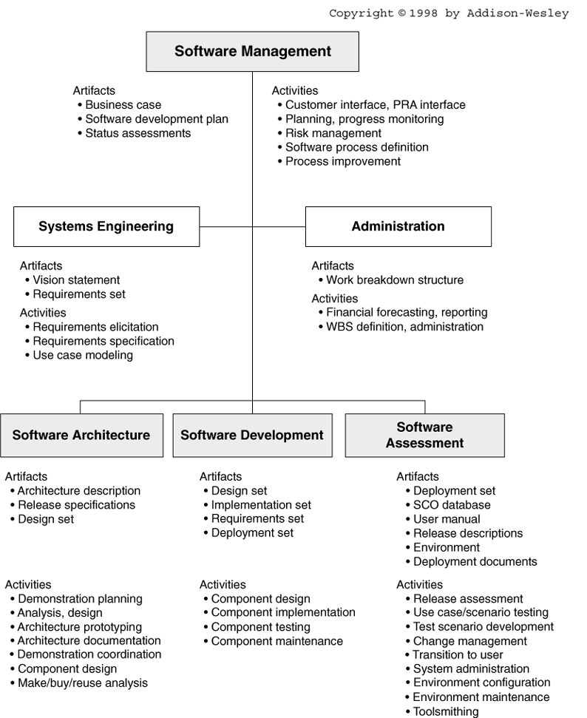
Project Organization & Responsibilities

Slide 6
Infrastructure
Project administration
Time accounting systems, contracts, pricing, terms and conditions, corporate information systems integration.
Engineering skill centers
Custom tools repository, bid and proposal support, research and development.
Professional development
Internal training, personnel recruitment, personnel skills database, library, technical publications.

Slide 7
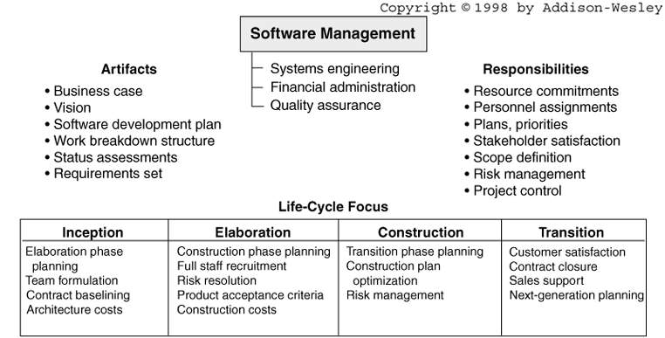
Software Management Team Activities

Slide 8
Software Management Team
Primary concern:
Balance for delivering to stakeholders – customers, higher management, users, developers.
Main responsibilities:
Planning, execution, adaptation, resource management, setting priorities, controlling, taking responsibility for quality.

Slide 9
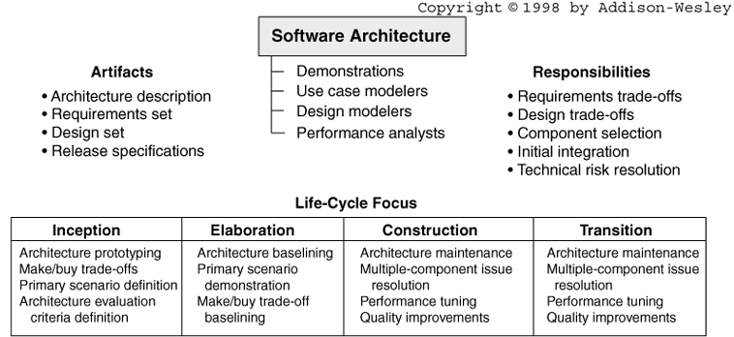
Software Architecture Team Activities

Slide 10
Architecture Team
Domain experience
To produce an architecture and design and a use case view.
Software technology
To produce a process view (concurrency and control, and component and deployment views.

Slide 11
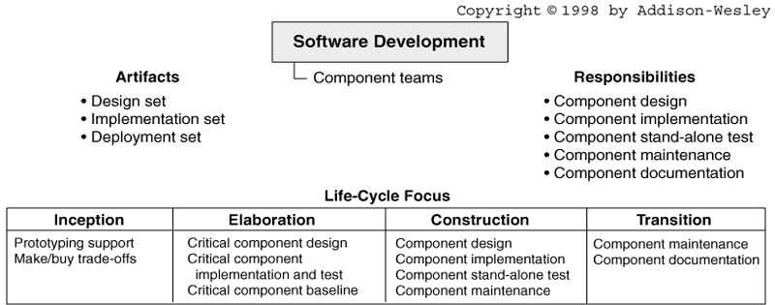
Software Development Team Activities

Slide 12
Development Team Skill Set
Commercial component
Specialists with detailed knowledge of commercial components.
Database specialists
Graphical user interfaces
Display organization, user interactions, outputs, control needs.
Operating systems and networking
Specialists in execution of multiple software objects on a network of hardware resources; control issues for initialization, synchronization, resource sharing, and inter-object communications.
Domain applications

Slide 13
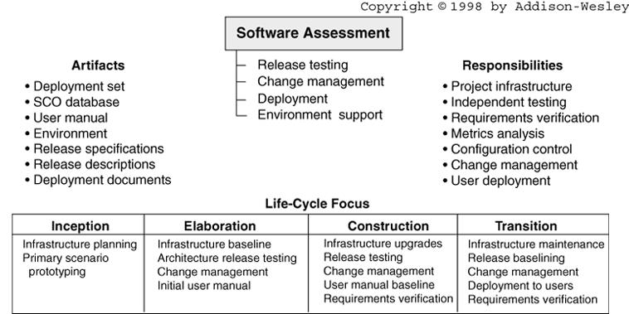
Software Assessment Team Activities

Slide 14
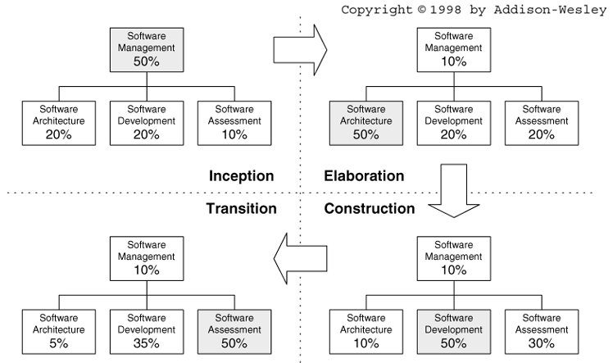
Software Project Team Evolution

Slide 15
Assignment for Next Class Meeting
Read Chapter 11 of Royce’ book, on project organization.
Learn and discuss the similarities and the differences between the Line-of.-Business organization and the Software Project organization.
Learn and discuss the responsibilities of the software management organization.

