Slide 1
Iterative Process Planning
Software Management
(from Part III, Chapter 10 of Royce’ book)

Slide 2
Topic for Today
Iterative Process Planning
Work Breakdown Structures (WBS)
Planning Guidelines
The Cost and Schedule Estimating Process
The Iterative Planning Process

Slide 3
Conventional breakdown structures
Conventional work breakdown structures are project-speciﬁc, and cross-project comparisons are usually difﬁcult or impossible. Most organizations allow individual projects to deﬁne their own project-speciﬁc structure tailored to the project manager’s style, the customer’s demands, or other project-speciﬁc preferences. With no standard WBS structure, it is extremely difﬁcult to compare plans, ﬁnancial data, schedule data, organizational efﬁciencies, cost trends, productivity trends, or quality trends across multiple projects. Each project organizes the work differently and uses differ- ent units of measure

Slide 4
Recommended WBS
First Level
  Workflows for WBS elements. Can be allocated to single teams.
Second Level
  Defined for each phase of the life cycle.
Third Level
  Focus on the activities that produce the artifacts of each phase.

Slide 5
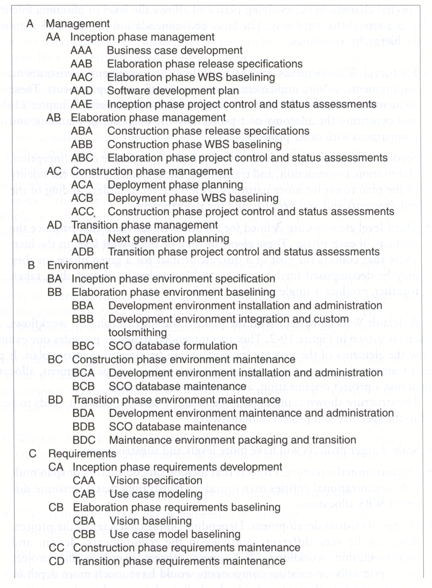
Work Breakdown Structure

Slide 6
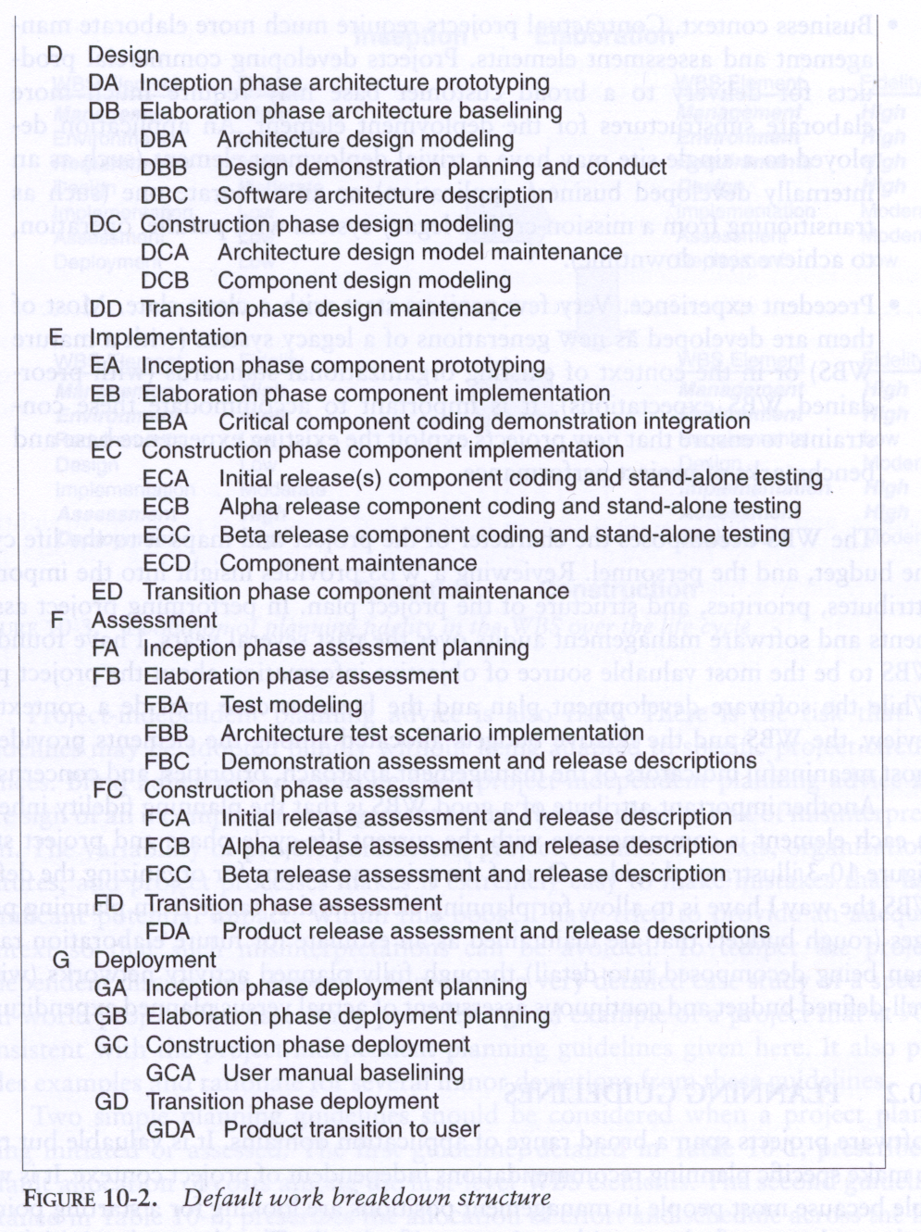
WBS (cont’d)

Slide 7
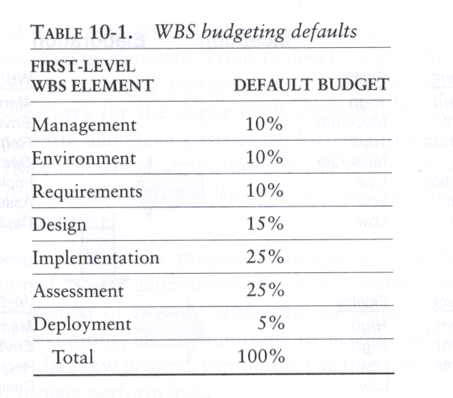
WBS Budgeting

Slide 8
Effort and Schedule By Phase

Slide 9
Iterations
Inception stage
  Prototypes, critical use cases, existing components, custom component prototypes.
Elaboration stage
  Architecture, initialization, scenarios, peak load conditions, worst case control flow, fault tolerance.
Construction stage
  Alpha and beta releases, execution of all critical cases, 95% of capabilities demonstrated.
Transition stage
  Resolve all defects, incorporate beta feedback, incorporate performance improvements.

Slide 10
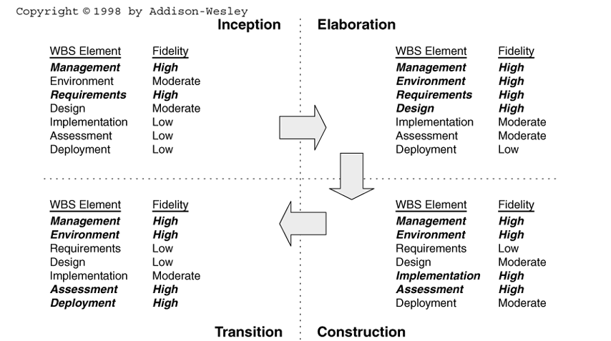
Evolution of Planning

Slide 11
Cost and Schedule Estimating
Steps – Top Down
1. Software project manager characterizes overall size, process, environment, people and quality.
2. Software manager makes a macro-level estimate of effort and schedule using software cost estimation model.
3. Software manager partitions the effort in top-level WBS.
4. Subproject managers decompose each WBS element into lower levels.

Slide 12
Cost and Schedule Estimating Steps – Bottom Up
  Lower level WBS elements are elaborating into detailed tasks by responsible WBS element managers.
  Estimates are combined and integrated into higher level WBS elements.
  Comparisons are made with the top down budgets and schedule milestones. Large differences are reconciled to converge on agreements.

Slide 13
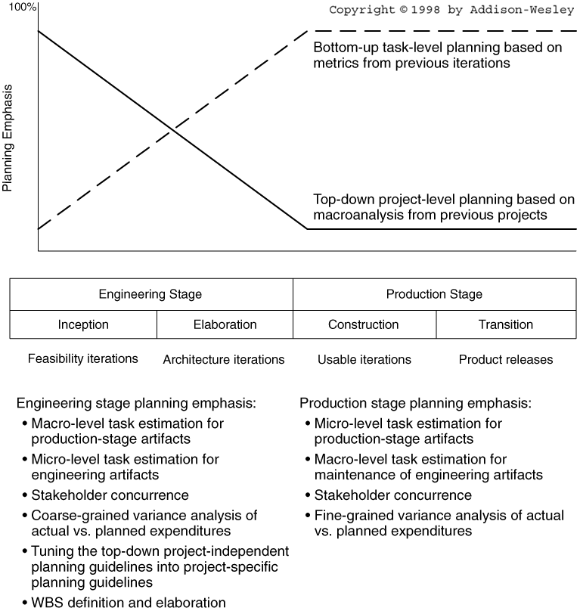
Planning Balance Across Life Cycle

Slide 14
Assignment for Next Class Meeting
Read Chapter 10 of Royce’ book, on iterative process planning.
  Learn and discuss the similarities and the differences of top-level organization of a conventional WBS and the top-level organization of a modern WBS.
  Learn and discuss the similarities and the differences between the four steps for a top-down cost and schedule estimate and the three steps for a bottom-up cost and schedule estimate.
  Learn and discuss the similarities and the differences of the contents of the iterations in each of the four development phases.

