Slide 1
Object Oriented Programming in C++

Slide 2
Distribution of Marks
Internal Sessional Evaluation
Assignments – 10
Quizzes – 10
Class Participation Attendence – 5
Mid – Term Test – 25
External Evaluation
Terminal Exam – 50

Slide 3
Course Overview
The Big Picture
C++ Programming Basics
Loops and Decisions
Structures
Functions
Objects and Classes
Arrays and Strings
Operator Overloading
Inheritance
Pointers
Virtual Functions
Streams and Files
Multifile Programs
Templates and Exceptions
The Standard Template Library
Object – Oriented Design

Slide 4
Procedural Languages
Program consists of list of instruction
E.g. Get some input, add these numbers, divide by six, display that output
NO organizing principle: complexity increases with increase in program size
Example
C, Pascal, FORTRON

Slide 5
Procedural Languages (Cont’d)
Division into Functions
Large program divided into small functions
A function has a clearly defined purpose and a clearly defined interface to the other functions
Module: is grouping of functions togeather into larger entity called module

Slide 6
Structured Programming
Dividing a program into functions and modules to improve clarity, quality of a program
Two related problems with structured programs
Unrestricted Access
Unrelated data and procedure

Slide 7
Unrestricted Access
In procedural language, two kinds of data
Local data
Local access to function
Safe from modification by other functions
int AddNumber()
{
int num1;
int num2;
int num3;
num3 = num1 + num2;
return num3;
}

Slide 8
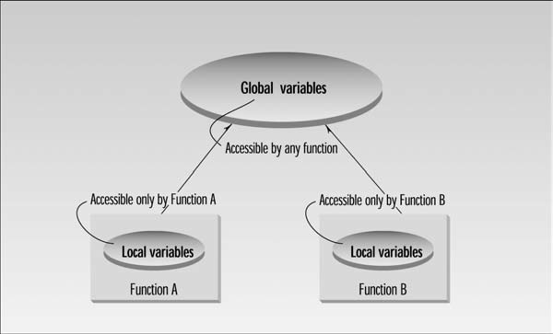
Unrestricted Access (Cont’d)
Global data
When one or more function must access same data
Can be accessed by any function in a program
Difficult to modify the program

Slide 9
int num1=2;
int num2=5;
int num3;
Void AddNumber()
{
num3 = num1 + num2;
}
Void SubNumber()
{
num3 = num2 – num1;
}

Slide 10
Unrelated data and procedure
In a large program, there are many functions and many global data items
The problem with the procedural paradigm is that this leads to larger number of potential connections between functions and data
It makes a program’s structure difficult to conceptualize
It makes the program difficult to modify

Slide 11
Cont’d

Slide 12
Real – World Modeling
Physical World entities like car, people
Focus on real objects to be mapped in computer program
Objects has
Attributes – characteristics
For people; eye color, job title
For cars; horsepower, number of doors
Behavior
Is like function: call a function to do something

Slide 13
Object Oriented Approach
In C++, an object function is called member function
Data is hidden to outside world
Object data can be accessed via member functions
Objects can communicate with eachother by calling one another’s functions

Slide 14
Charactristics of Object – Oriented Languages
Objects
Classes
Inheritance
Reusability
Polymorphism and overloading

Slide 15
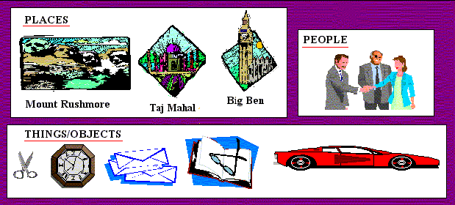
Object
An Object is a computer representation of some real-world thing (i.e. person, place).
Objects can have both attributes and behaviors

Slide 16
Object (Cont’d)
When an object is mapped into software representation, it consists of two parts:
PRIVATE data structure characteristics of private data structure are referred to as ATTRIBUTES e.g. FirstName, LastName, Color etc.
PROCESSES that may correctly change the data structure
Processes are referred to as OPERATIONS or METHODS e.g. SetFirstName(), SetColor()

Slide 17
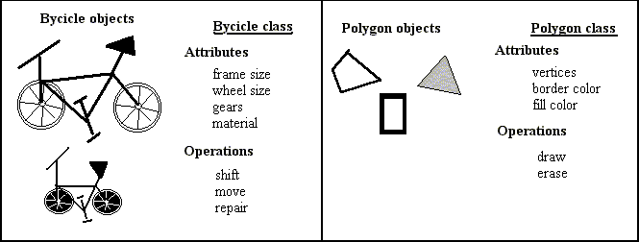
Class
Objects with the same data structure (Attributes) and behavior (Methods or Operations) are grouped together called a class
Multiple objects can be created from the same class

Slide 18
The object-oriented paradigm

Slide 19
Inheritance
Inheritance is a mechanism that allows you to base a new class upon the definition of a pre-existing class
Subclass inherits all properties of its superclass and can define its own unique properties.
Subclass can redefine inherited methods.
Generalization: process of forming a superclass
Specialization: forming a subclass

Slide 20
Reusability
Once a class has been written, created and debugged, it can be distributed to other programs to reuse in their own programs called ”reusability”
E.g. Library of functions, third party softwares
Inheritance provides important extention to the idea of reusability
Reduces software development time

Slide 21
Polymorphism
Polymorphism means “many forms”
In programming terms, many forms mean that a single name can represent different code selected among by some automatic mechanism.
E.g. In real world, the word “OPEN” can be use with different objects like
Open door
Open window
Open box

Slide 22
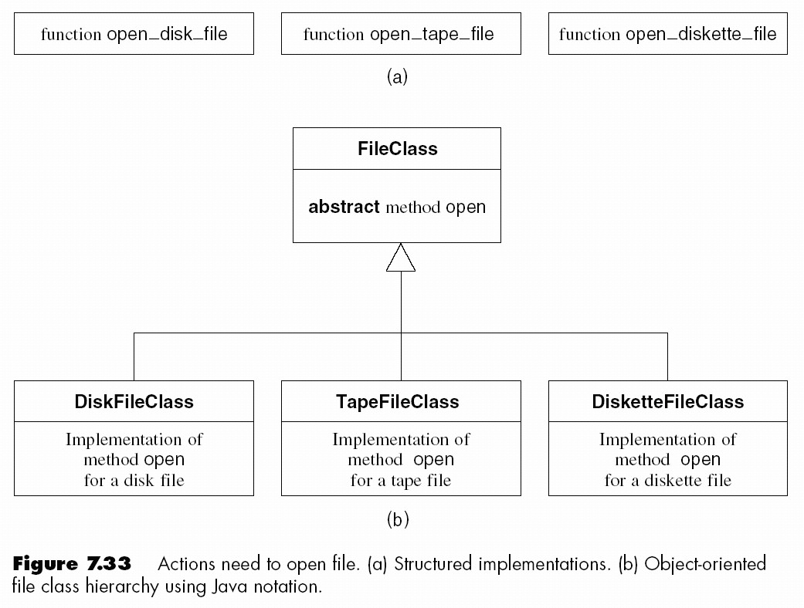
Polymorphism – Example

Slide 23
Overloading
Overloading is kind of polymorphism
The ability of existing operator or function to operate on new data type is said to be overloaded
E.g.
Void Compute(int a, int b)
{
int c;
c = a + b;
}
Void Compute(long a, long b)
{
long c;
c = a + b;
}

Slide 24
Unified Modeling Language (UML)
Graphical representation for modeling computer programs
UML began as three modeling languages
Grady Booch
James Rumbagh
Ivar Jacobson
Why UML?
Hard to understand program by looking at code
Model program to see bigger picture

Slide 25
UML (cont’d)
UML is set of different kinds of diagrams
Class diagrams: shows relationship between classes
Object diagram: how specific objects relate
Sequence diagram: show communication among objects over time
Use case diagram: how program’s user interact with the program

Slide 26
Basic Program Construction
#include <iostream>
int main()
{
cout<<” Every age has a language of its own\n ”;
return 0;
}

