Slide 1
Welcome to Unix The Textbook Second Edition
Presented by: Sarwar
Haroon Haider Khan Koretsky
Sarwar

Slide 2
Chapter 0 A quick start into the UNIX Operation System

Slide 3
Introduction
Founder
Names: Ken Thompson, Dennis Ritchie, Brian Kernighan, Douglas
McIlroy, Michael Lesk and Joe Ossanna
Company: AT&T employees at Bell Labs, including
Year of introduction: 1969
UNIX Coding
Language: C/C++

Slide 4
Structure of UNIX Command All UNIX commands are case sensitive and only small caps run
command
lpr
Correct and incorrect
Lpr
lPr
lpR
LPr
LPR
LpR
lpr
Command to print

Slide 5
Structure of UNIX Command All UNIX commands are case sensitive and only small caps run
Structure of command
command [{-}option(s)] [command argument(s)]
lpr -P apr proposal.txt
The file name which will be
Printed out
Command to print
Option pointing towards
a printer name
Name of the printer

Slide 6
Structure of UNIX Command All UNIX commands are case sensitive and only small caps run
Structure of command
command [{-}option(s)] [{-}option argument(s)] [command argument(s)]
lpr -P apr -n 3 proposal.txt
Command to print
Option pointing towards
a printer name
Option use for number of copies
to be printed out
The file name which will be
Printed out
Name of the printer
Three copies will be printed out

Slide 7
Structure of UNIX Command All UNIX commands are case sensitive and only small caps run
Structure of command in some other shell
command [{-}option(s)] [{-}option argument(s)] [command argument(s)]
lp -d apr -n 3 proposal.txt
Command to print
Option pointing towards
a printer name
Option use for number of copies
to be printed out
The file name which will be
Printed out
Name of the printer
Three copies will be printed out

Slide 8
CONNECTIONS
Internet Connection
Wide area Connection
Local Area Connection
Stand Alone Connection
Connection Requirements
User
Password
Ip address
Port some times

Slide 9
Session Requirements (log in and log out)
Stand alone pc Requirements:
User (optional)
Password (optional)
Local Area Network pc Requirements:
User
Password
System name or IP address
Wide area Network Pc Requirements:
User
Password
System name of IP address
Port number (optional, default ports ftp 21,telnet 23,ssh 22)

Slide 10
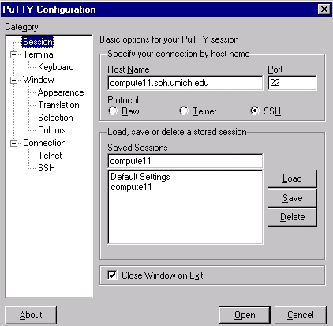
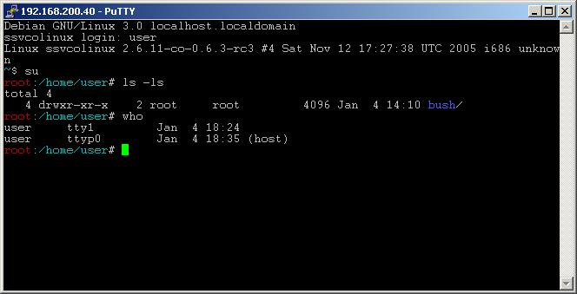
CONNECTIONS
Putty : Its an application which is used to connect a pc with a Remote pc.

Slide 11
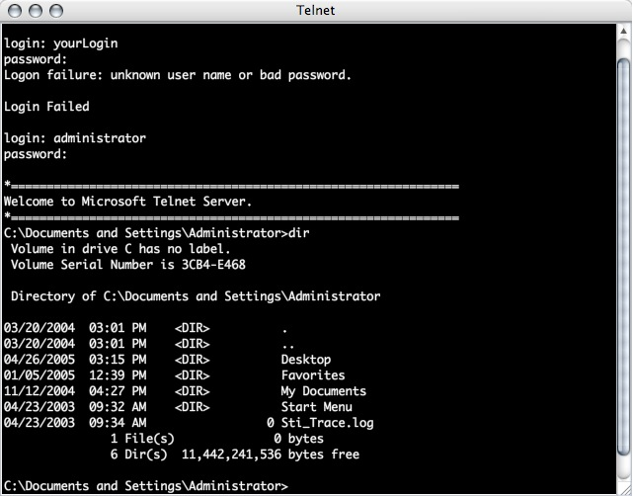
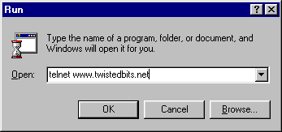
CONNECTIONS
Telnet : Its an application which is used to connect a pc with a Remote pc.

Slide 12
UNIX File System
/
|--bin
|--boot
|--dev
|--etc
|--home
| |--bilal
| |--abid
| | |--myfolder
| |--usman
|--misc
|--lost+found
|--mnt
|--opt
|--root
|--sbin
|--usr

Slide 13
Directory structure
/ “native root” – It is the main directory in which all the rest UNIX directories are located
/bin -It requires about 550mb of space, contain essential commands used by the system
when running and booting UNIX.
/sbin -It requires about 550mb of space, contain essential commands used by the system
when running and booting UNIX.
/boot -It contains UNIX kernel which is loaded at boot time.It also contain files that contain
information for booting Linux.
/dev -It contains 7500 files representing devices.
/etc -It contains more then 20mb system configuration files and directories .Containing
some major software packages like apache , Openssh and passwd file.
/home -It contains the directories of all the normal users, when ever a new user is created
then automatically a directory will be created by his/her name inside home directory.
when ever a user will login then he/she will automatically will jump in his/her home
directory.
/proc -It only exist while UNIX is running and it shows different memory usage.
/usr -It is approx 5GB in size and contains software applications and libraries.
/tmp -it is used for temporaty file storage.The tmp directory is cleaned of each day and will
delete files that are not used for 10 days.
/var -It contains directories and sub directories used by various system services e.g mail ,
ftp etc…

Slide 14
To View The Contents of The File
File having only 24 lines
File having 164 lines
cat - (It is used to view the contents of a file, with >
sign it will insert data Into the file and over write
it and with >> it will append the data and will
Not over rite the previous data.)
cat fileabc
cat > fileabc
this is my first file line 1
Ctrl+d
command to save and exit
cat >> fileabc
I am appending the file
Ctrl+d
1st line
2nd line
3rd line
4th line
5th line
..
..
..
23rd line
24th line
141line
142 line
143 line
144 line
145 line
..
..
..
163 line
164 line
before
after
1st line
2nd line
3rd line
4th line
5th line
..
..
..
23rd line
24th line
this is my first file line 1
before
after
1st line
2nd line
3rd line
4th line
5th line
..
..
..
23rd line
24th line
141 line
142lline
143 line
144 line
..
..
163 line
164 line
I am appending the file

Slide 15
To View The Contents of The File
File having only 164 lines
Enter button pressed once
more -(It is used to view the contents of a file, by
pressing space bar it will show next 24 lines
of the file ’page by page’ and by pressing enter
button it will show next line of the file ’line by line’)
more fileabc
Ctrl+z or Q (to exit)
1st line
2nd line
3rd line
4th line
5th line
..
..
..
23rd line
24th line
2nd line
3rd line
4th line
5th line
..
..
..
23rd line
24th line
25th line
Space bar pressed once
26th line
27th line
28th line
29th line
30th line
..
..
..
48rd line
49th line

Slide 16
Some Basic Commands All UNIX commands are case sensative and only small caps run
Command:
cp -it is used to copy a file or directory
cp fileab fileAB (copying file on the same location )
cp fileab /home/ali (copying file on a different location)
cp –R mydirectory mydirectorybk10sep13 (copying directories and sub directories etc..)
Command:
mv -it is used to move a file or directory
mv fileab fileAB (rename file on the same location )
mv fileab /home/ali (move file on a different location)
mv fileab /home/ali/file12 (move/rename file on a different location)
mv –R mydirectory mydirectorybk10sep13 (renaming directories name )
mv –R mydirectory /home/ali/ (moving directory and sub directories inside to a
different location)
mv –R mydirectory /home/ali/mydirbk4sep13 (moving directory and sub directories
inside to a different location and will
rename it as well)
Command:
rm -it is used to delete a file or directory
rm fileab (delete fileab )
rm –R mydirectory (delete mydirectory and sub directories + files inside )

Slide 17
Some basic commands
List down files and directories
ls =list down all the files and directories.
ls –a =It will list down all hidden the files and directories
ls –la =It will list down all hidden the files and directories in detail
bin dev home lib etc myfilea mYfilea myFilea
mnt usr myhomedirbk17oct2013.tar
.profile .login bin dev home lib etc myfilea mYfilea myFilea
mnt usr myhomedirbk17oct2013.tar
-rwxrwxrw- 1 root root 5 aug 2008 17:34 .profile
drwxrw-rw- 2 root root 8 aug 2010 12:34 bin
-r—r—r-- 1 usman ali 14 sep 2005 05:12 Myfilea

Slide 18
Commands
Creating files and directories+ special characters
rm file* -It will remove all the files starting from the name file no matter
how lengthy there name is, will remove file1, file111, fileabc43er, fileg
* is a meta character which has a special meaning behind it (meaning every
thing)
rm file? -It will remove all the files starting from the name file and just one more
extra character in the name, will remove file1, fileB, filec, file8.
? again is a meta character which has a special meaning behind it (meaning
just one character or letter), it acts like a fill in the blank
rm f?l? -It will remove all the files starting with the first letter f and the second may
be any character/number ,third letter must be l and fourth may be any
character/number f just one more, will remove file, fBl2, f5l7, f9le, f3lg.
? again is a meta character which has a special meaning behind it (meaning
just one character or letter), it acts like a fill in the blank, in this example
there are two fill in the blanks
touch -It will create an empty file, e.g touch mynewfile
mkdir -It will create a directory ,e.g mkdir mydir32

Slide 19
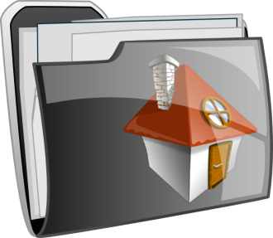
Commands
Back to user Home directory
When ever a new user is created, UNIX will automatically create a
folder by exact user name on the path /home
cd -To move and to go into the home directory of a user. If user usman
is on the path /home/ali and he want to go to his home directory which
will be /home/usman then he will type the command cd
cd $HOME -To move and to go into the home directory of a user. If user usman
is on the path /home/ali and he want to go to his home directory which
will be /home/usman then he will type the command cd $HOME
cd ~ -To move and to go into the home directory of a user. If user usman
is on the path /home/ali and he want to go to his home directory which
will be /home/usman then he will type the command cd ~
cd .. -it will go one step back. Moving back one step in the directory structure.
pwd -it will show and print on the screen your present working directory path.
meaning where you are your current position in the directory structure.

Slide 20
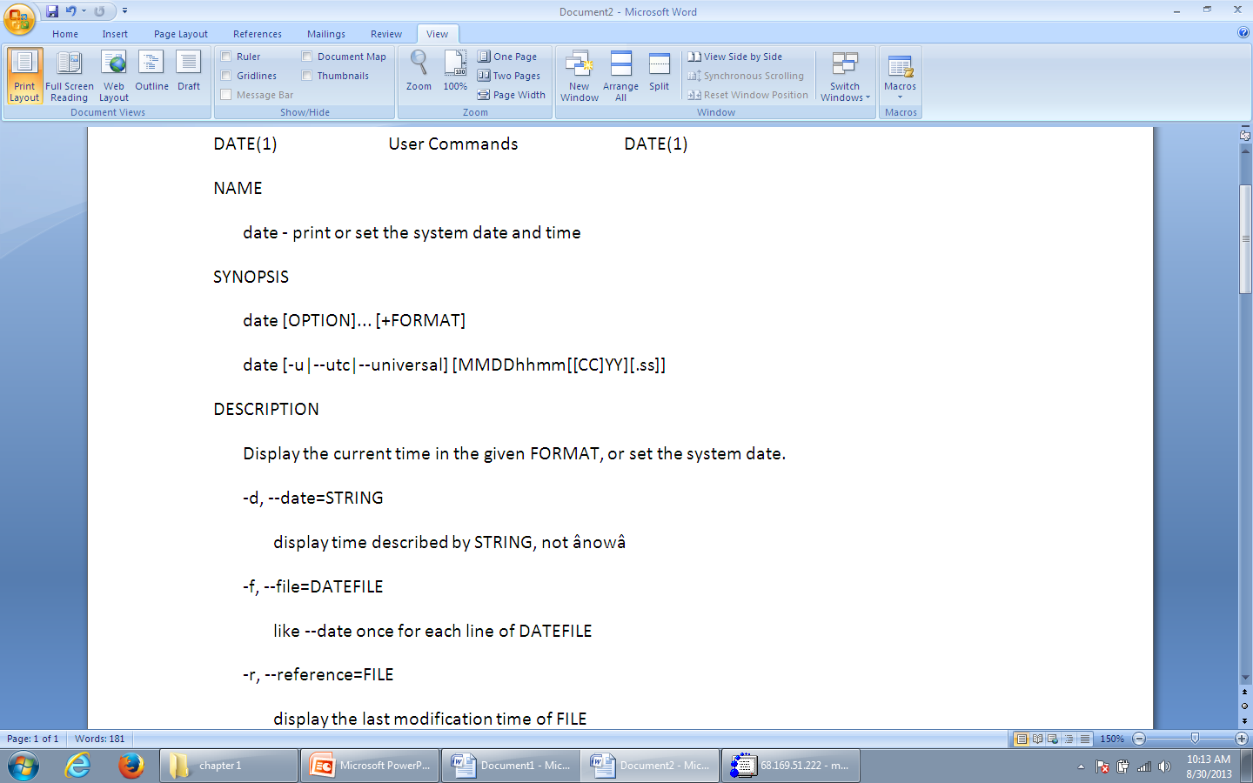
Some Basic Commands All UNIX commands are case sensitive and only small caps run
Command:
man date
Out put:
Will display complete manuals how to use the date command ‘the
date command is used to show or set system date and time’
UNIX manuals are also kept on
/usr/share/doc

Slide 21
Commands
Some important commands of this chapter
whereis -It will find out the command and its documents on the entire
file system and will display the ourput along with the path
e.g whereis fdisk .
whatis date -It will display the important options and how date command
work with different options, basically it is a help command.
whoami -It will display a persons current user id
man ls | lpr -Pspr -This is the combination of 2 commands by a piping ‘|’
it will print out the manuals of ls command from the
Printer naming spr which is on a network.
cal -To open up calandar
write -This command is used to send messages to others , useful
Chat application. Ctrl+d is used to send a message.
In order to communicate , both end users should accept
messages by tying ‘mesg y’. If ‘mesg n’ is set by a use
then no one can send him/her messages except the
super user/root user/system admin.

Slide 22
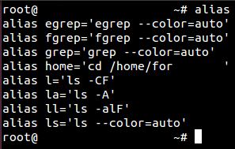
Commands
alias commands “nickname”
alias -To give a short name to a
command ‘nickname’ so
next time instead of typing a lengthy name , just type the
alias and command will execute .Typing just alias will print
all the current alias.
alias dt=‘date’ -A new alias dt is created , now instead of typing date only dt
will print the current date and time on the screen.
unalias -It will take away the nick name or the short name.

