Slide 1
Administering Your Network

Slide 2
Dedication
We dedicate our presentation to our PARENTS, who taught me that the best kind of knowledge to have is that which is learned for its own sake.
And
To our Teacher, who taught us that even the largest task can be accomplished if it is done one step at a time.

Slide 3
Contents Outline
The Network Administrator
Creating a Network Environment
Network Software
Server Software
Applications Software
User Accounts & Groups
Protecting Your Network Environment
Managing Your Network Environment
Questions

Slide 4
The Network Administrator
The network administrator is the one you never see, because you never see a network problem.
The network administrator is individual primarily responsible for the uninterrupted proper operation of the network.

Slide 5
Creating a Network Environment
Choose an administrative plan to meet specified needs, including performance management, account management and security .
Three facts of your network are most strongly affected by how your company works, and these three facts define how your network appears to your user.

Slide 6
Creating a Network Environment
These three facts are:
What network software is loaded on the server?
How user accounts are set up?
How “group accounts” are set up, how & what “user accounts” are assigned to them?

Slide 7
Network Software
There are two types of Network Softwares:
Server Softwares
Application Softwares

Slide 8
Server Softwares
What are Server Softwares?
Database.
Database files stored on the server.
Shared data files.
Groupware, e-mail & scheduling.
Internet connectivity & allowing web access.
Hosting.

Slide 9
Application Softwares
What are Server based Application Softwares?
Antiviruses.
Driver Applications.
Anti-Hacker Applications.
Fault Detectors.
Backup & Restore Applications.

Slide 10
User Accounts
The default account.
Creating user account in windows server 2008.
Creating Template for user account.
Disabling & deleting user account.
Renaming user account.
Home directories .

Slide 11
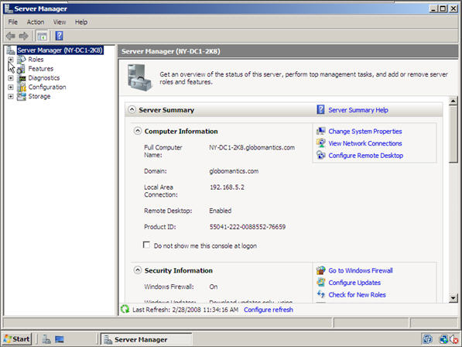
To start open “Server Manager”

Slide 12
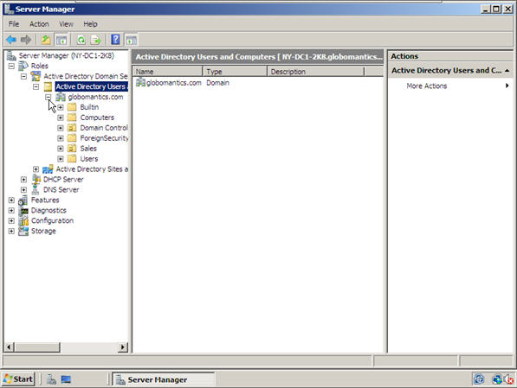
Next we will open up the Roles section, next to Active Directory Users and Computers section and finally the Active Directory Users and Computers. You should now see your domain name.

Slide 13
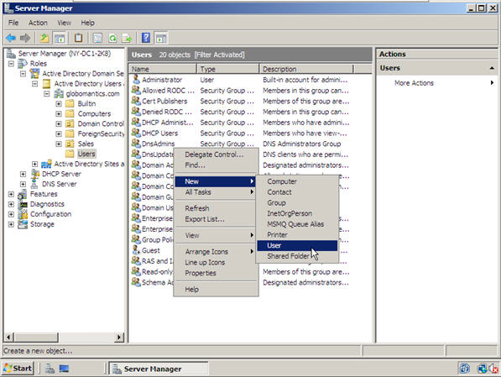
We are going to click on our Users section where we are going to create a new User Account. To do so, right-click on the blank section, point to New and select User.

Slide 14
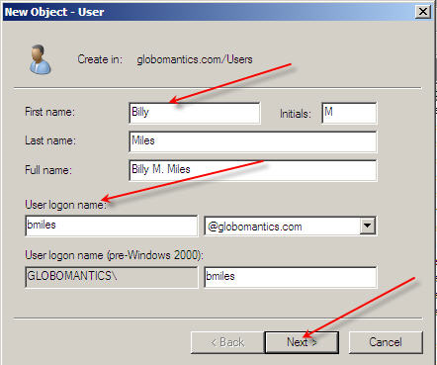
In this window you need to type in the user’s first name, middle initial and last name. Next you will need to create a user’s logon name.

Slide 15
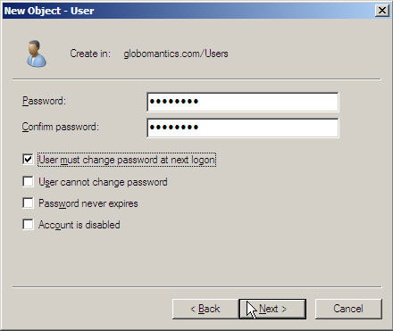
In the next window you will need to create a password for your new user and select appropriate options.

Slide 16
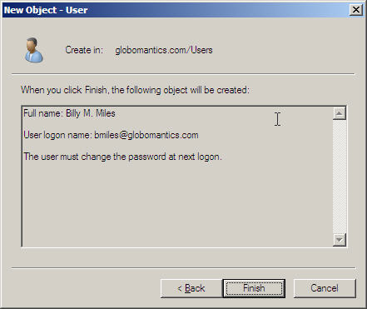
And finally, click on the Finish button to complete the creation of new User Account.

Slide 17
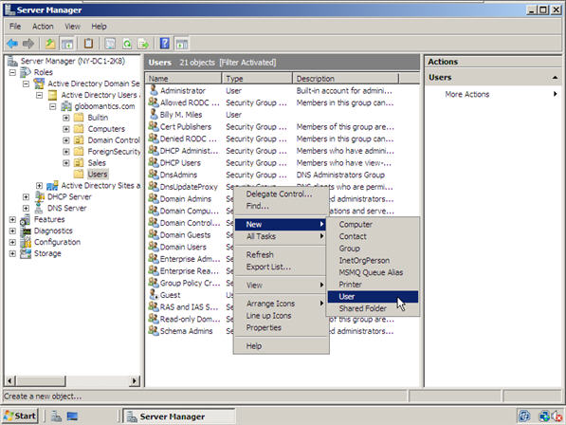
Predefined User: To start out, right-click on the empty space, point to new, and select User.
Click Here on empty white space!

Slide 18
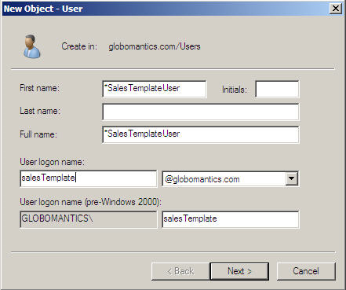
Type in the user’s name (if you want, otherwise don’t write in these fields) and click Next.

Slide 19
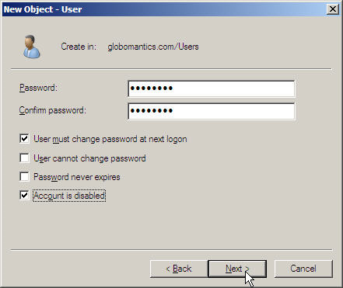
Create the template’s password and do not forget to check the box next to the Account is disabled option. When ready, click Next.

Slide 20
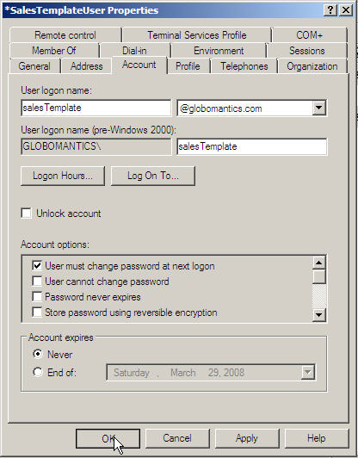
Once the account is created, you can go ahead and add all the properties you need for that template. To do so, double-click on that account and navigate to a specific tab. Once done click OK.

Slide 21
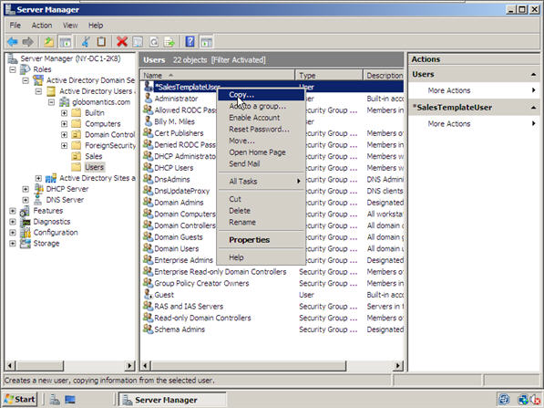
How to Create a User Template account? we are going to select it, copy it and add the unique information such as user name, password, etc. We can do that for as many users as needed. Let’s start by right-clicking on the template and selecting Copy.

Slide 22
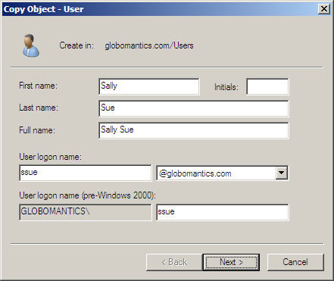
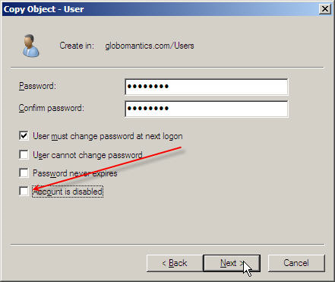
Next we are going to enter the user’s name, login and password information while making sure the checkbox next to Account is disabled is unchecked this time.
Once we finish, our new user account is created
with all the properties of the template account.

Slide 23
Disabling & Enabling User Accounts
To open active directory users and computers, click start, click control panel, double-click administrative tools, and then double-click active directory users and computers.
In the console tree, click users.
In the details pane, right-click the user.
Depending on the status of the account, do one of the following:
To disable the account, click disable account.
To enable the account, click enable account.

Slide 24
Group Accounts
There are four types of Group accounts:
Local Groups
Global Groups
Special Groups
Built-in Groups

Slide 25
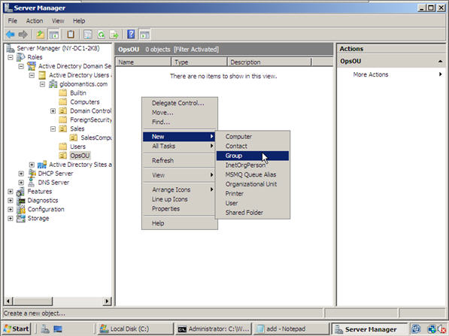
Creating a New Group

Slide 26
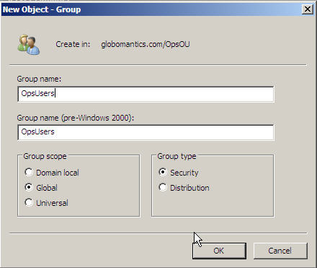
The next step is to name your Group, select the scope and then select the type.

Slide 27
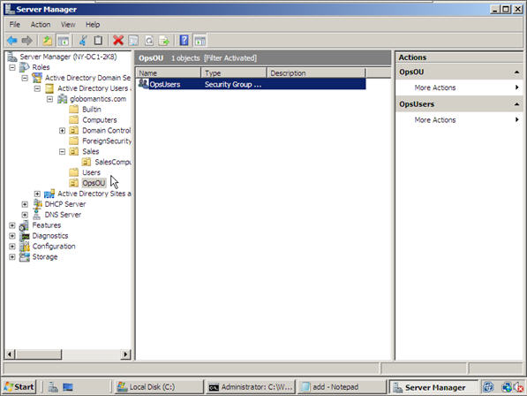
Our new group has been created!

Slide 28
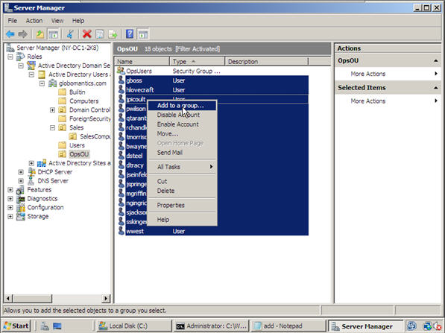
Moving Accounts Into a Group

Slide 29
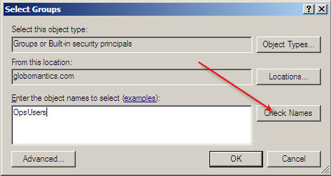
Next, you need to type in the group name and let the machine find it.

Slide 30
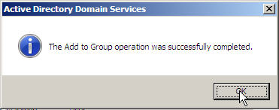
Now this prompt will show that our group operation completed successfully.

Slide 31
Built-in Groups
There are several predefined groups for specified network administrator:
Account Operators
Administrator
Backup Operators
Domain Admins
Domain Guests
Domain Users
Guests
Print Operators
Replicators
Server Operators
Users

Slide 32
Protecting Your Network Environment
How to Protect your Network Environment?
Security
How much security is enough?
How Important is your data?
What is risk of sharing data?
What is the possibility of accidental loss?
Creating a security plan
External requirements
Policies
Virus Protection
Uninterrupted Power Supply

Slide 33
Protecting Your Network Environment
Disaster Recovery
Backup policy
Drives (CDs, DVDs & HDDs)
Location of Backup system
Replication
Fault Tolerance
Mirroring

Slide 34
Managing Your Network Environment
Monitoring Network Performance
Performance Monitor.
Network Monitor.
Automated Network Management.
Hardware Upgrade Policy
Capacity of Admin to the whole cover network.
Capacity of Clients Computers.
Capacity of Data Storage .
Reliability of Network.

