Slide 1
Chapter 6 Electronic Mail

Slide 2
PORTS
Sending Mail Port ‘SMTP’ 25
Incoming Mail Port ‘POP3’ 110
KINDS OF EMAIL PROGRAMS
User Agent program -read ,compose ….
Transfer Agent program -send ,receive ….
KINDS OF ATTACHMENTS
Text file
Jpg. Mp4 ….
FEATURES OF EMAIL
To,
From,
Subject,
Cc,
Bcc,
Attachment

Slide 3
UNIX offers 3 Types of Mail Systems
1- Mail command line mail system
2- Pine Mail System as a graphical flavor
3- Kmail Mail System it also has a graphical flavor

Slide 4
UNIX offers 3 Types of Mail Systems
1- Mail command line mail system
2- Pine Mail System as a graphical flavor
3- Kmail Mail System it also has a graphical flavor

Slide 5
UNIX offers 3 Types of Mail Systems
Mail command line mail system
Commands
mail to go into the mail box
mail –s to send mail with subject
mail –s ‘hello’ ali@yahoo.com
mail –c carbon copy
mail -b blind carbon copy
mail –s-c ‘hello’ ali@yahoo.com bilal@hotmail.com
Hello world this is the first mail that I am sending
Ctrl + D #
To dispatch and go back to shell prompt

Slide 6
UNIX offers 3 Types of Mail Systems
1- Mail command line mail system
2- Pine Mail System as a graphical flavor
3- Kmail Mail System it also has a graphical flavor

Slide 7
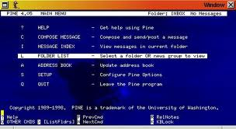
PINE Mail Systems
Splash screen
Command with option
pine -i “directly going to inbox , by passing splash screen

Slide 8
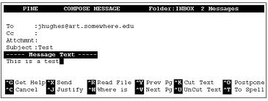
PINE Mail Systems
Some Command in splash screen
C “to compose a new message”
OR
Pine bilal@hotmail.com

Slide 9
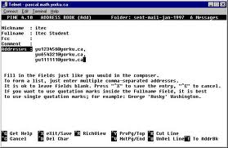
PINE Mail Systems
Fcc - “” in the fcc field , this will not send
attachment to that particular address
Pine address book display

Slide 10
UNIX offers 3 Types of Mail Systems
1- Mail command line mail system
2- Pine Mail System as a graphical flavor
3- Kmail Mail System it also has a graphical flavor

Slide 11
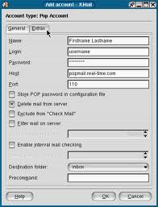
KMAIL Mail Systems # kmail

Slide 12
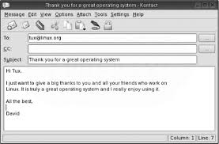
KMAIL Mail Systems composing a message

