Slide 1
Characters & Fonts
Digital Multimedia, 2nd edition
Nigel Chapman & Jenny Chapman
Chapter 7
This presentation © 2004, MacAvon Media Productions

Slide 2
Text
314–315
Dual nature
Visual representation of language (content)
Need to relate bit patterns to symbols of a written language
Graphic element (appearance)
Precise shapes of characters, spacing and layout (typography)
Each abstract character may have many different graphic representations

Slide 3
Character Sets
315–316
Abstract characters are grouped into alphabets
Any set of distinct symbols, usually forming the basis of some written language
A character set is a mapping between the characters of some alphabet (its character repertoire) and bit patterns
For each character in its repertoire, a character set defines a code value, belonging to its set of code points

Slide 4
ASCII
317
American Standard Code for Information Interchange
7 bits for each code value, hence 128 code points
Character repertoire only comprises 95 characters (other 33 values are used for control characters)
Character repertoire is only really adequate for American English
ISO standard ISO 646 is ASCII with national variants (accented letters, currency symbols)

Slide 5
8-bit Character Sets
318
Easy to double the number of code points by using the eighth bit of a byte
Maintain backward compatibility by keeping lower half (0–127) identical with US-ASCII
Use code points 128–255 for accented letters, math symbols, extra punctuation
256 code points still insufficient for all languages, so must still use different variants ('code pages')

Slide 6
ISO 8859
319
Incompatible 8-bit extensions to ASCII were originally developed by manufacturers
Standardization required
ISO 8859 is a multi-part standard which defines a collection of character sets, each designed to accommodate the needs of a group of related languages
ISO 8859-1, known as ISO-Latin1, covers most Western European languages

Slide 7
Multi-byte Character Sets
320
256 code points is not sufficient for ideographically based alphabets or for using more than one language at a time
16-bit (2-byte) character set with 65,536 code points can accommodate 256 8-bit character sets simultaneously, and so on with 24- and 32-bit sets
ISO 10646 is structured as a hypercube comprising 256 groups (cubes) each of 256 planes of 256 rows, each with 256 characters

Slide 8
Structure of ISO 10646
320
Each code point can be written as a quadruple (g, p, r, c) – group, plane, row, character
Using * to mean all values from 0–255, can also use quadruples to identify subsets
(0, 0, 0, *) is the subset with all but lowest-order byte set to 0
In ISO 10646, (0, 0, 0, *) is identical with ISO Latin1

Slide 9
Unicode
320–321
16-bit character set developed by an industry consortium
Unicode uses CJK consolidation to fit all characters required for Chinese, Korean and Japanese into 16 bits
Characters that look the same have the same position, even if they are in fact different
ISO 10646 Basic Multilingual Plane (0, 0, *, *) is identical to Unicode (even though ISO 10646 doesn't really need to use CJK consolidation)

Slide 10
Encodings
322–323
Mapping from code values to a sequence of bytes
charset specification in a MIME type identifies encoding and character set
e.g. text/html; charset = ISO-8859-1
Obvious encoding of ISO 10646 uses four bytes for each 32-bit value – UCS 4
For values on BMP drop zero bytes – UCS 2
UCS 2 is therefore identical to Unicode

Slide 11
UTFs
323
UCS Transformation Formats can be applied to Unicode (UCS 2) values
UTF-8: ASCII characters encoded as themselves, values > 127 encoded as a string of up to six bytes with highest bit set to 1
UTF-7 further encodes UTF-8 as 7-bit values to avoid problems with older protocols
UTF-16 allows pairs of 16-bit values to be combined into a single 32-bit value, extending Unicode beyond BMP (additional 15 planes)

Slide 12
Fonts
324–326
Visual representation of a character is called a glyph
Must replace characters with glyphs for display
Glyphs are arranged into collections called fonts
Fonts are stored in specified locations on a computer system, may be embedded in documents
If font is not embedded, document may not display properly on systems where that font is not installed

Slide 13
Classification of Fonts
327–330
Spacing: monospaced (fixed width)/proportional
Serifs: serifed/sans serif
Serifs are the small strokes added to the ends of character shapes in conventional book fonts
Shape: upright/italic/slanted
Slant is a vertical shear effect, italic uses different glyph shapes with a slant
Weight: bold/normal/light

Slide 14
Choice of Fonts
331–332
Text fonts – suitable for continuous text (e.g. body of a book or article)
Must be unobtrusive, easy to read
Display fonts – suitable for isolated pieces of short text (e.g. headings, signs or slogans)
Intention is to get a short message across, so eye-catching design that would be inappropriate for continuous text is OK

Slide 15
Fonts for Multimedia
332–333
Text fonts may be problematical
Low resolution of computer displays leads to loss of details (e.g. fine serifs) and distortion of letter shapes
Use larger sizes than in print, prefer sans serif, use fonts such as Arial and Verdana designed to be readable at low resolution
Display fonts work better and may be suitable for small pieces of continuous text

Slide 16
Font Measurement
334–335
Units
Points: 1pt = 1/72" = 0.3528mm
Exact size is not standard; 1/72" is invariably used by computer systems
Picas: 1pc = 12pt
Font's body size is not necessarily the size of any particular character
e.g. 10pt Times Roman

Slide 17
Font Terminology
337
Baseline – the line on which the bases of characters are arranged
Leading – the distance between successive baselines
x-height – the distance between the baseline and the top of a lower-case letter x
Ascenders/descenders – strokes that rise above the x-height/drop below the baseline

Slide 18
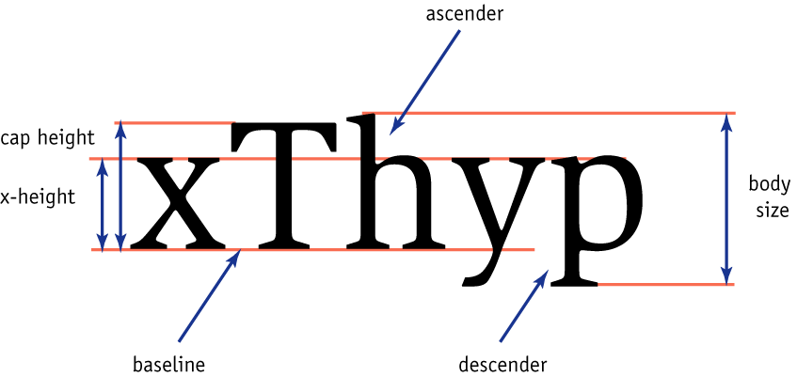
336

Slide 19
Relative Units
336–337
Used to express measurements relative to font size
1 ex = font's x-height
1 em = body size
Traditionally the width of an upper-case M
Long dashes — known as em-dashes (1em long)
1 en = 0.5em
Shorter dashes – known as en-dashes (1en long)

Slide 20
Spacing
337–338
Kerning – adjustment of space between certain pairs of letters (e.g. AV) to make them look more uniform
Kerning pairs for a font are defined by its designer, stored with the font metrics
Ligatures – single composite characters used to replace pairs of letters that don't look right next to each other (e.g. fi)
Ligatures are stored as extra characters in the font

Slide 21
Digital Fonts
339
Glyphs are just images, so we can have bitmapped or vector (outline) fonts
Bitmapped fonts don't scale well or reproduce at different resolutions
Outline font formats:
PostScript Type 1
TrueType
OpenType

Slide 22
Outline Fonts
340–341
Type 1
Character shapes are based on Bézier curves
Fonts can contain hints used by rendering programs to improve appearance at low res
TrueType
Character shapes are based on quadratic curves
Instructions specify how features of a character are rendered at different resolutions

Slide 23
OpenType Fonts
340
New cross-platform format that unifies Type 1 and TrueType
More than 256 characters in each font
Type 1 and TrueType both limited to 256
Encoding based on Unicode
Support for extended range of ligatures, old-style numerals, swash capitals, fractions

