Slide 1
Chapter 5
Life-Cycle Phases
From
Software Project Management
By
Walker Royce (of IBM)
And Slides on Spiral by Barry Boehm

Slide 2
Introduction
On one hand,
Do we spend far too much time on analyses and paper studies?
Do we delay actually doing the builds: the development baselines?
Very easy to do… Some feel in general that this is true…
On the other hand,
Do we jump into designs and coding, and hack the heck out of an application in attempts to get it to work?
Lots of people think we do this too….
Class discuss:
What do you do?
What do you think corporations think they do?

Slide 3
Introductory Statement:
Walker Royce feels that we need BALANCE between research and development (R&D) and production activities
Need some kind of balance between:
Concentrating on capturing and modeling functionality and
Building a robust product that has the performance, reliability, and scalability customers desire….
We are after a development life-cycle BALANCE…

Slide 4
Finer Granularity
Further, we need a process that supports this balance.
Need this stated more precisely:
➔ Need a process to help balance:
Planning, capturing, and modeling requirements and establishing a baseline architecture,
with
Continuous assessment, measuring risk, and testing to ensure progress and quality
with
Evolution and verification of the application’s functionality through series of customer demonstrations and ultimate validation.

Slide 5
Engineering and Production Stages
Royce claims to achieve the ROI for software development, we need to use a ‘manufacturing process’ that is characterized by the
highest utilization of automated development tools and
use of component-based approaches to development.
He likens a desirable software process to a manufacturing process:

Slide 6
Engineering and Production Stages
He breaks all activities down into
Engineering and Production
Engineering work: This centers on risk reduction, prototyping, establishing architectural baseline, assessment, analysis, design, and planning…
Implies a smaller team up front.
Production work: programming and unit test, system and integration testing, demonstrations, assessment, base-lining configuration, and releases; operations
Note that production includes operations…

Slide 7
Two Stages: Far Too Abstract
BUT, he argues a life cycle of two stages is far too abstract to track the many detailed activities – all with actors, activities, and artifacts….
So, he maps Rational Unified Process (RUP) Phases into these more comprehensive phases.
Enter: Engineering Phase = Inception and Elaboration
Enter: Production Phase = Construction and Transition
Engineering, i.e., Inception and Elaboration, focuses on the concept (idea) of the application and its architectural components (analysis and preliminary design – perhaps a wee bit of detailed design)
Artifacts are established and base-lined; (Configurations…)
Production, i.e., Construction and Transition, focuses on programming, testing, releases and converting / establishing operational capabilities
Implies that artifacts from earlier stage (engineering) more difficult to change as activities more ‘downstream activities’ occur

Slide 8
Spiral Model - Overview
Spiral Model is another incremental model.
Embraces (well known for these:)
prototyping,
iterative software development, and
risk assessment.
Model is graphed like a spiral.
Development can be halted at the end of any cycle…depending on evaluation of previous ‘cycle.’

Slide 9
Spiral Model
Very much a Risks-Driven Approach
Different idea of software development.
How does this project affect the developers
and the clients?
How does each step in the project affect
its overall development?
Not used in previous development models.
They were usually code-driven or document-driven.

Slide 10
Previous Software Process Models
An evolution of models
–Code & Fix
–Stagewise & Waterfall
–Evolutionary Development.
Code & Fix
• First, elementary model
• Write code now; fix it later
• No planning involved
• Problems:
– Code is poorly structured.
– The software developed was usually a poor match for users’ needs.

Slide 11
Stagewise & Waterfall
Born out of the shortsightedness of the Code & Fix model.
- need for a design phase, requirements phase,
and a testing phase.
First used to develop SAGE (Semi-Automated Ground Environment), an early warning system for the Cold War era.
The Semi-Automatic Ground Environment (SAGE) was a system of large computers and associated networking equipment that coordinated data from many radar sites and processed it to produce a single unified image of the airspace over a wide area. SAGE directed and controlled the NORAD response to a Soviet air attack, operating in this role from the late 1950s into the 1980s. Its enormous computers and huge displays remain a part of cold war lore, and a common prop in movies such as Dr. Strangelove and Colossus.

Slide 12
Stagewise
A development process of successive phases.
– Phases included operational plan, operational
specs, coding specs, coding, parameter
testing, assembly testing, shakedown, system
evaluation.
Underwent two refinements in 1970.
Now referred to as the Waterfall Model.

Slide 13
Waterfall Model
Introduced:
– Feedback loops across multiple stages:
Validation and verification steps.
– Prototyping via a “build it twice” step alongside of
requirements and design.
• Difficulties exposed even as revisions were made to
the model.
– Required elaborated documents. (Document- driven; lengthy development cycles, etc.
– Led to pursuing stages of development in the wrong order

Slide 14
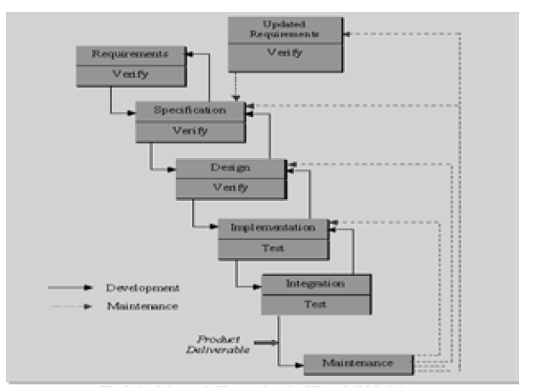

Slide 15
Evolutionary Development
Evolution of the system in directions based on experience.
Provides rapid initial operational capability.
“I can’t tell you what I want, but I’ll know it when I see it.”
Flexible, yet uncertain approach.
Evolutionary Development Problems:
No formal design phase (same problem as Code & Fix).
One bad assumption – the unplanned paths “will” be compatible.
Hard-to-change code resulted.
Many problems when new software was incrementally replacing old software

Slide 16
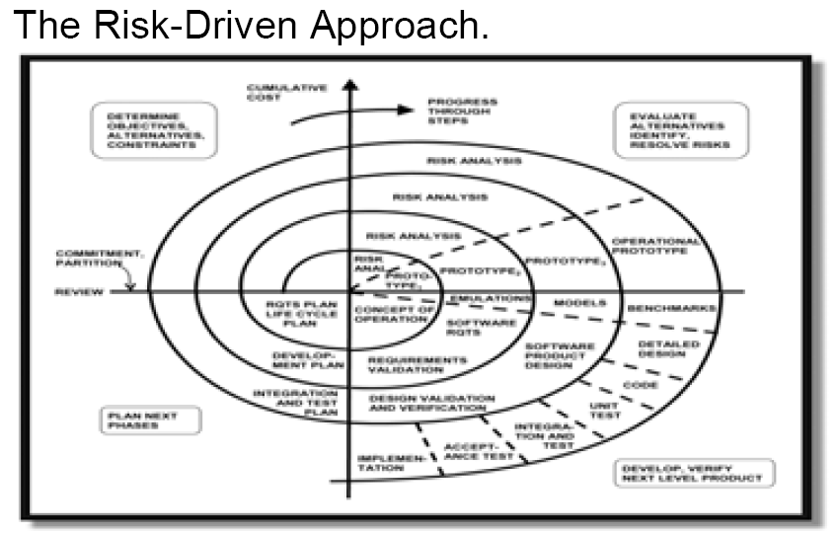

Slide 17
Spiral Model - Overview
In the Spiral Model, prototyping, evaluation, planning, and all engineering and production activities are executed in different quadrants. (Different variations of the model…)
But the basic notion of iteration is very firmly established.
For each ‘cycle’:
risk is assessed,
more design and development is undertaken,
the work products and evaluated, and
planning for the next cycle in the spiral is undertaken;
Iterate…..
Please note that in reality, the Spiral Model curve is actually skewed to the right, as the spirals do not ‘carve’ out equal ‘areas.
Area in each cycle is a determinant of effort and cost….

Slide 18
Spiral Model and the RUP Phases
R & D Stage
Production Stage
Inception
Elaboration
Construction
Transition
Idea
Architecture
Beta Releases
Products
Prototypes
artifacts
Major risk items
Creative, judgment
Business Rules
Stakeholder Vision
Change managed baselines
Elaborate artifacts
Low Risk Items
Engineering, reasoned
Well-instrumented processes
‘Skewness:

Slide 19
Back to our Process Model (Rational Unified Process)
Let’s look more closely at the phases for our process model:
Inception
Elaboration
Construction
Transition
Each phase has
primary objectives,
essential activities, and
primary evaluation criteria
to judge its success at milestone time.
➔Since the process that is underpinning our management of software processes and personnel course is the RUP, it is imperative that we understand this management process, the RUP, as much as possible

Slide 20
Inception Phase (1)
Overriding Goal: achieve concurrence among stakeholders on life-cycle objectives for the project (milestone: LCO)
Primary Objectives: (by end of phase…)
Establish project software scope and boundary conditions
Includes operational concept, acceptance criteria, and a clear understanding of what is and what is not intended in the product
Identify critical use cases (core functionalities) of system and the primary scenarios that will drive the activities
Demonstrate at least one candidate architecture against some of the primary scenarios (walk through it…)
Estimate the cost and schedule for the entire project (including detailed estimates for the elaboration phase)
Estimate potential risks (sources of unpredictability)
Know These!

Slide 21
Inception Phase (2)
Essential Activities
Develop Project Scope
Capture requirements and concept of operations → repository
Describes users’ view of the requirements
Repository contains information used to define problem space
Repository must contain information to capture acceptance criteria
Develop a Candidate Architecture and Demonstrate it
Repository contains enough information to demonstrate at least a single candidate architecture
This might be at a very high level, such as deployment level;
A general layered architecture may also be demonstrated.
But considerable Requirements have not yet been done and almost NO Analysis and Design have been undertaken.
Repository must include enough data to support make/buy decisions so that cost, schedule, resources can be ‘costed out.’
Planning and Preparing the Business Case
Risk management strategies, staffing, general iteration plans, cost/schedule/profitability tradeoffs are all evaluated.
Environmental (Infrastructure) support is defined.
ROI, market share, etc.

Slide 22
Elaboration Phase (1)
Clearly the most important phase! Overriding goals are several, varied, and critical!
➔ At end of phase:
engineering is complete,
almost all use cases are designed (certainly all critical use cases and flows),
a prototype for gathering requirements and to demonstrate proof of concept is accommodated, and
an analysis model is constructed, and
a baseline executable architecture is established and demonstrated.
Risks have to have been addressed and strategies understood;
Business Rules have been subscribed to closely;
Cost and schedule are acceptable and predictable and updated, if necessary,
Stakeholder acceptance is achieved (the vision is realized in the artifacts), etc. and
We have stability…
→ We want to graduate from a low-cost effort into a full-blown production process, where costs are maxed and personnel are on staff.

Slide 23
Elaboration Phase (2)
➔ Primary Objectives (at end of phase…)
Base-lining the architecture asap (establishing configuration management procedures…for tracking all artifacts!
Base-lining the Vision. It is now ‘solid’ and accommodated in the artifacts so far.
Base-lining a detailed plan for Construction
Demonstrating the baseline architecture such that it clearly supports the vision – at, of course, reasonable cost in reasonably time.

Slide 24
Construction Phase (1)
Great mindset change: now interested in producing a deployable product! (implementation)
iterate, iterate…, integrate/assess/plan as we go.
No longer ‘engineering;’ rather, production!!!
Need to manage resources, control operations to optimize costs, schedules, and quality.
Emphasis on the development of intellectual property shifts to the reality of usable products.

Slide 25
Construction Phase (2)
One very nice attribute in Construction:
Parallel development
Based on architecture…do homework up front!!!!
Accelerates delivery of deployable releases
Downside: complicates project management and synchronization of teams, integration, and workflow.
Architecture will drive this
A good architecture will support parallel development
Emphasized during Elaboration – planning for Construction.

Slide 26
Transition Phase
Phase concludes when the baseline realizes the original vision and we are ready to put it in the users’ hands.
Might be end of project development or starting point for next cycle, or starting point for next version of deployable version...
Might be forwarding ‘whole shooting match’ over to
the maintenance group or
third party for future work…

Slide 27
Transition Phase
Transition is not uncomplicated
May involve several iterations including
Beta1, beta2, testing and ‘levels’ of releases (all releases may not be equal)
Custom software?
Conversion software?
Development of user documentation,
User training, especially in initial use of product
Web-X; on developer’s site; on client’s site.
Who pays for what? How does this work? Millions!!!
Usability problems and tuning,
(Un)solicited feedback, and more….

Slide 28
Transition Phase
Essential Activities
“Synchronization and integration of concurrent construction increments into consistent deployable baselines” – ensure all flows…
→Installation / Conversion
Cut over (complete switch to new application)
Run in parallel, or
Phased…
Assessment against vision and acceptance criteria.
Evaluation Criteria
Is user satisfied?
Are actual expenditures reasonably close to planned expenditures?

Slide 29
Summary - Know These
Recognize each phase has one or more iterations
Phases end with major milestones; (Know these!)
Iterations within phases have minor milestones.
Each have deliverable(s) and undergoes assessment against criteria
Each iteration entails a sequence of activities that culminate in a minor milestones or major milestones (if iteration ends phase)
Scope and results of iterations are captured via artifacts produced.

Slide 30
Summary (continued) – Know!
Major Milestones (phase end):
Approved by stakeholders
Map to significant management/business decisions rather than to completion of a specific software development activity.
Minor milestones (iteration end):
Approved internally and
Realized by artifacts / new versions of artifacts in repository;
internal synchronization,
internal assessment,
Additional planning take place…
‘Executable’ releases (not necessary deployable…)

Slide 31
Lessons Learned – Organizational Change
Middle management is where the war is won
Championed by respected leaders who own the plan and execution.
Project Management: Can be immense pressures from above (Sr. Management) and different sets of problems/issues from below (actual developers)
ROI on first implementation
Disruption costs must be absorbable in the benefit
Implemented on business critical project
This is where the A-players are
Success breeds success – (like the NFL)
First increment needs to be ambitious, but realistic
Results drive incentives
Such as: milestone demonstrations, release timeliness, release content, etc
Not: processes, methods, expended energy, reuse, audits, meetings, subjective assessments, document production,…

