Slide 1
Chapter 4 UNIX Shells

Slide 2
Some basic commands
List down files and directories
ls =list down all the files and directories.
ls –a =It will list down all hidden the files and directories
The hidden files like .profile and .login are also known as system start up files .
bin dev home lib etc myfilea mYfilea myFilea
mnt usr myhomedirbk17oct2013.tar
.profile .login bin dev home lib etc myfilea mYfilea myFilea
mnt usr myhomedirbk17oct2013.tar

Slide 3
Session
To end a Session
COMMANDS
logout
exit
Ctrl+D

Slide 4
Commands
Some important commands of this chapter
echo $SHELL -It will display the information of a shell
csh -To change a shell. e.g to switch from bourne shell to Cshell .
Bourne Shell
C Shell

Slide 5
Commands
Meta characters or special characters
rm file* -It will remove all the files starting from the name file no matter
how lengthy there name is, will remove file1, file111, fileabc43er, fileg
* is a meta character which has a special meaning behind it (meaning every
thing)
rm file? -It will remove all the files starting from the name file and just one more
extra character in the name, will remove file1, fileB, filec, file8.
? again is a meta character which has a special meaning behind it (meaning
just one character or letter), it acts like a fill in the blank
rm f?l? -It will remove all the files starting with the first letter f and the second may
be any character/number ,third letter must be l and fourth may be any
character/number f just one more, will remove file, fBl2, f5l7, f9le, f3lg.
? again is a meta character which has a special meaning behind it (meaning
just one character or letter), it acts like a fill in the blank, in this example
there are two fill in the blanks

Slide 6
Chapter 5 File Editors

Slide 7
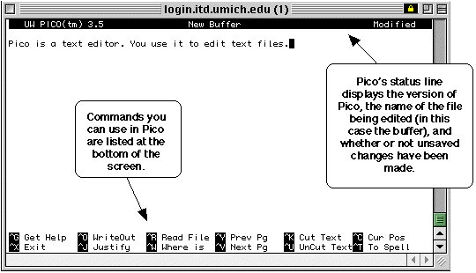
Working with file editors Pico
Name of the editor command to open screen shot
Pico file editor pico myfile
CTRL X to exit

Slide 8
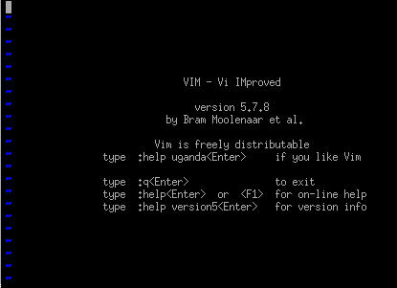
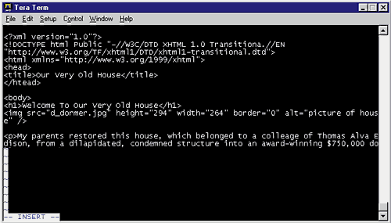
Working with file editors vi
Name of the editor command to open screen shot
vi file editor vi myfile
:q to quit
:w to save
:wq to save and exit
I -going to insert mode
Ecs -going to command mode

Slide 9
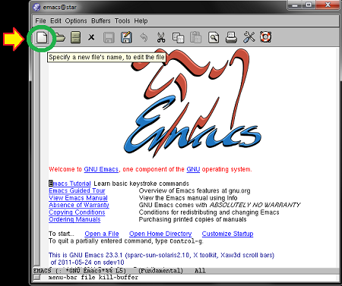
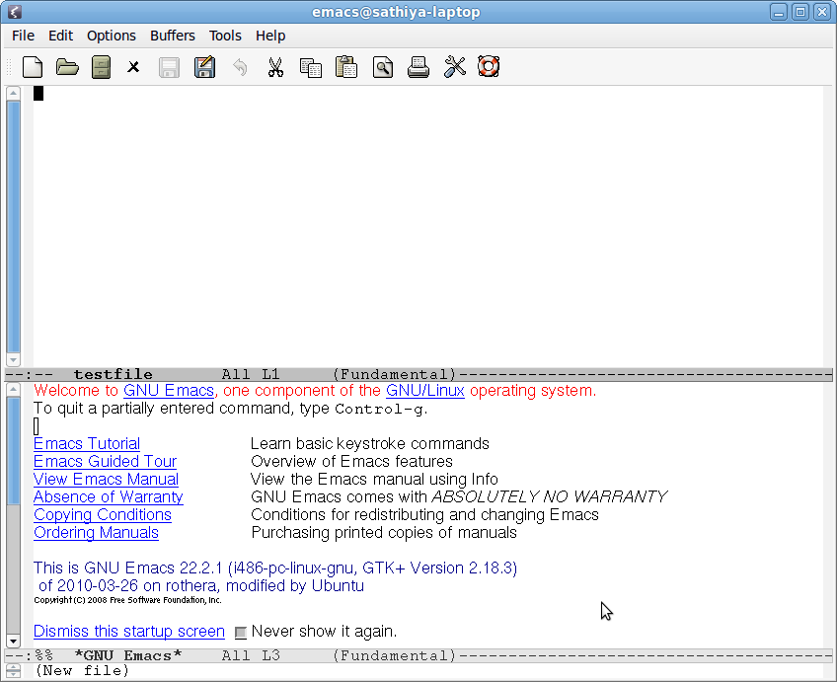
Working with file editors Emacs
Name of the editor command to open screen shot
Emacs file editor emacs myfile

