Slide 1
Welcome to Linux RedHat 9 Unleashed

Slide 2
Chapter 1 Introducing Red Hat Linux

Slide 3
Introduction
Founder
Name: Linus Torvalds
Country: Finland
Year of introduction: 1991
Linux Coding
Language: C/C++
Distributers
RedHat Linux 1994
Turbo
Easy Linux

Slide 4
Welcome to Linux world Servers around the world using linux
In 1994

Slide 5
Welcome to Linux world Servers around the world using linux
In 1994
By 2013
Most
Super
Computers

Slide 6
Why Linux ?
Better and Improved GUI (GNOME, KDE and TWM)
Font improvement
Improved software
Providing many utilities(open Office,Mozilla…)
In-built web server
Strong Kernel (load balancing)
Support more then 1000 printers
Virus free

Slide 7
Flexible Installation Process Both GUI and Text Base
Mostly used option
Custom- To install your own selected software packages.
Upgrade- To upgrade an existing system.
Server- To built a server.
Personal- To create a multimedia workstation.
Workstation- To create a development system.

Slide 8
File System of Linux
Two types of file extensions
ext 2 (old file system)
ext 3 (new file system)
ext 4 (in rare cases)

Slide 9
Kernel Series
2.2
2.4
2.5
2.6
The command to check kernel version
uname –r
The command to see the date when kernel was compiled
uname -v

Slide 10
Structure of Linux Command All linux commands are case sensitive and only small caps run
command
lpr
Correct and incorrect
Lpr
lPr
lpR
LPr
LPR
LpR
lpr
Command to print

Slide 11
Structure of Linux Command All linux commands are case sensitive and only small caps run
Structure of command
command [{-}option(s)] [command argument(s)]
lpr -P apr proposal.txt
The file name which will be
Printed out
Command to print
Option pointing towards
a printer name
Name of the printer

Slide 12
Structure of Linux Command All linux commands are case sensitive and only small caps run
Structure of command
command [{-}option(s)] [{-}option argument(s)] [command argument(s)]
lpr -P apr -n 3 proposal.txt
Command to print
Option pointing towards
a printer name
Option use for number of copies
to be printed out
The file name which will be
Printed out
Name of the printer
Three copies will be printed out

Slide 13
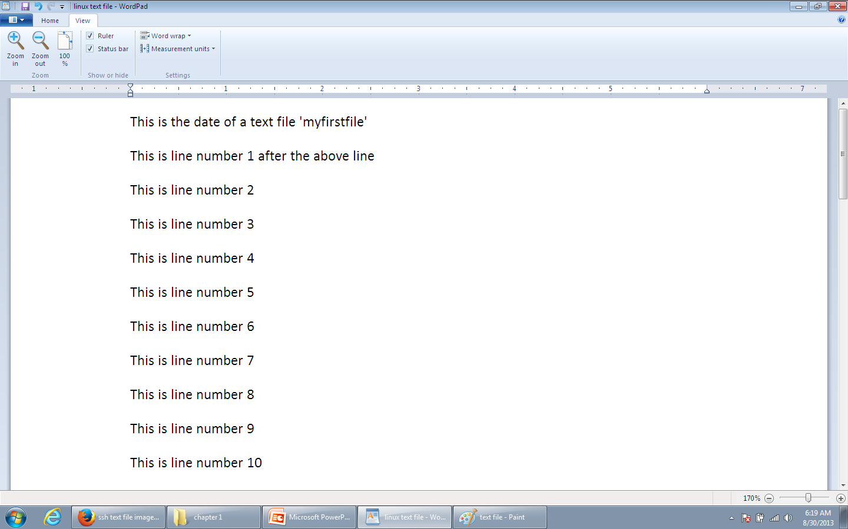
Some Basic Commands All linux commands are case sensitive and only small caps run
Command:
less
zless
Out put of less:
will display first few lines of a text file
Out put of zless:
will display first few lines of a zipped text file

Slide 14
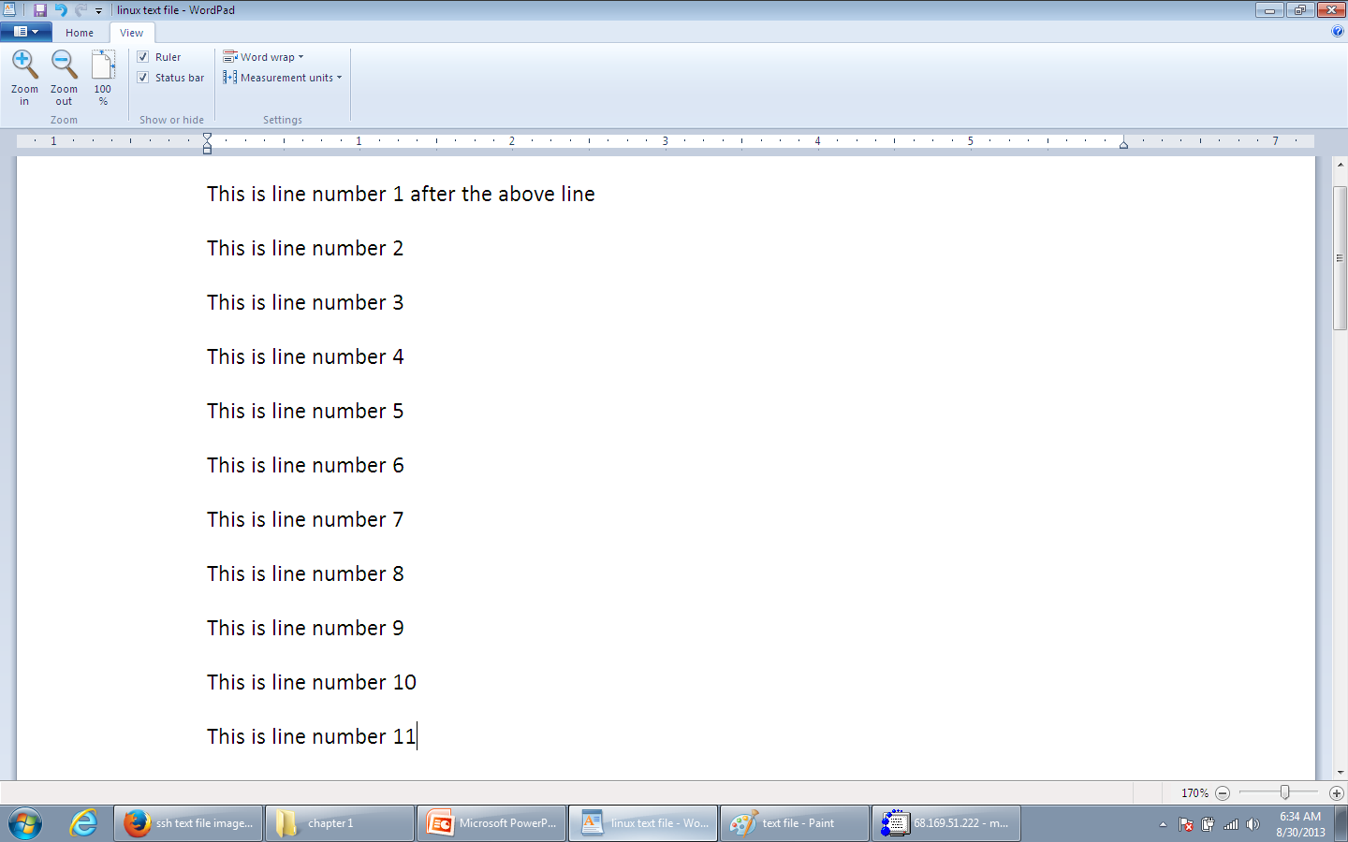
Some Basic Commands All linux commands are case sensitive and only small caps run
Keyboard action after the command less
enter button action
Output:
will display next line, (line number 11 is visible ,moving line by line)

Slide 15
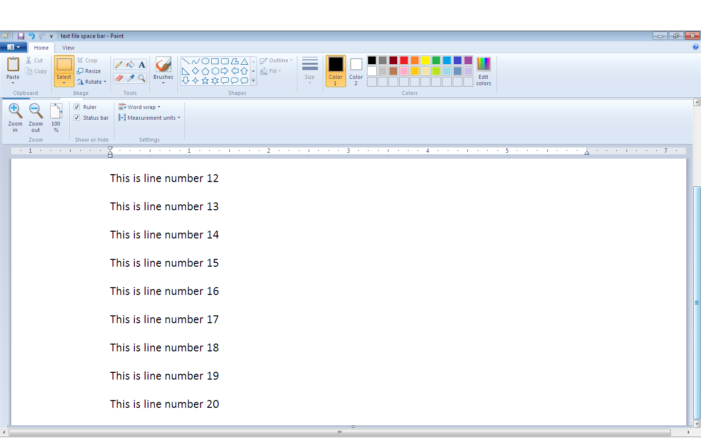
Some Basic Commands
Keyboard action after the command less
Space bar button action
Output:
will display next page, (line number 12 to 20 are visible
moving page by page)

Slide 16
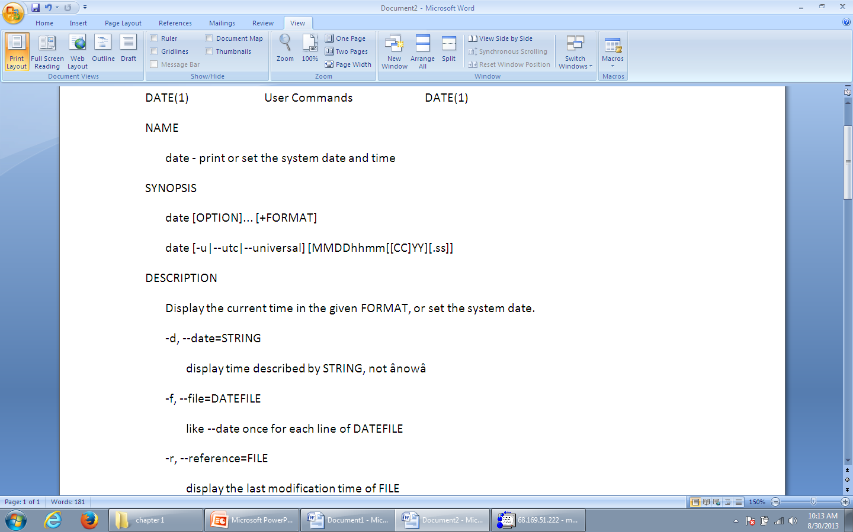
Some Basic Commands
Command:
man date
Out put:
Will display complete manuals how to use the date command ‘the
date command is used to show or set system date and time’
Linux manuals are also kept on
/usr/share/doc

Slide 17
Chapter 2 Preparing to Install Red Hat Linux

Slide 18
Planning the Red Hat Linux deployment
Business Consideration
Type of business (Small or Large)
Financial Cost
Compatibility
Specific objective of installation
System Consideration
Hardware/Software requirements
On a net work or stand alone
Level of security requirements
Storage (backup plan)
User Consideration
Special training for User and Administrators
Number and type of Users
Does the public needs to know (Backend activities on server)
Refer to table 2.1 page 30-31

Slide 19
Planning the Red Hat Linux Installation
Key factors to consider
Preparation
Pre-configuration
Linux provide pre-configured installation scripts for development , workstations , ecommerce and server needs- only the required software will be installed .
Ensuring Correct installation
Appropriate Hardware

Slide 20
Hardware Requirements
Minimum Hardware Requirements
Pentium CPU
650 MB hard disk space
64MB RAM
Installation Choice provided by Linux installer
Workstation: minimum 2.2 GB
Personal desktop: minimum 2 GB
Server: 350 MB to 5GB
Custom: 500MB to 5GB
To get the most out of your hardware,
don’t install any more software that required.

Slide 21
Problematic devices during Installation
Some USB devices
Wireless- Many 802.11b wireless USB network adapters
Scanner- Many Canon ,Visioneer and HP.
Webcams- Some Creative and Logitech
If a driver isn’t available, you have a few options, you can
download the driver’s source code and build the driver your self.
You can also check hardware compatibility http://hardware.redhat.com
/hcl/genpage2.cgi?pagename=hcl&view=advsearch#form
Refer to table 2.2 page 41-43 for the checklist

Slide 22
Preparing for the Install Process
RedHat Linux Installation Methods
CD-ROM- Using the cd-rom drive.
DOS- By using LOADIN, by running DOS batch file, autoboot. bat.
NETWORK FILE SYSTEM- installing from a remote hard drive.
FILE TRANSFER PROTOCAL- installing from a remote server.
HYPERTEXT TRANSPORT PROTOCAL- installing from a website.
INSTALLING VIA A INTERNET- same as point c,d and e.
HARD DRIVE PARTITION- Copying and installing from a partition
PREINSTALLED MEDIA- Install Linux on a different hard drive and then transfer the hard drive to your system .

Slide 23
Creating a bootable disk
To create a bootable floppy which can be helpful in future .
Command: dd
Complete command will be
Command: dd if=/mnt/cdrom/images/boot.img of=/dev/fdo bs=1440k
command to create copying floppy image floppy drive path speed
bootable floppy from cdrom

Slide 24
Partitioning before and during installation
Before installation partitioning softwares
DM9
Partition Magic
During installation
Native root (Its must and basic)
Swap (Its must and basic, its double the size of your RAM size)
Boot (Its optional , minimum 100 MB space)
home (Its optional )
/opt (Its optional )
/tmp (Its optional )
/usr (Its optional )
/var (Its optional )

Slide 25
Dual operating systems
You can install both operating systems on your system , the Golden rule is first install windows and then Linux
First Second

Slide 26
Mounting and unmounting
The command mount
After joining or mounting, you can read the data from the CD but you can not eject it.
The command umount
After un mounting you can not read the data from the CD but can now eject it.

Slide 27
Auto partition metion in Linux
Kickstart installation metiond:
Create a configuration file that will help kickstart to take input from.
User the kickstart command to let the system do the automatic partition (/usr/sbin/ksconfig).
Select the appropriate options in the dialogue box
A file by the name ks.cfg will be created , copy it on a floppy.
mount /mnt/floppy
cp ks.cfg /mnt/floppy
linux ks=floppy
umount /mnt/floppy
Uses:
Saves a lot of time
Saves effort
Unattended installation

