Slide 1
Chapter # 5
Designing a local area network

Slide 2
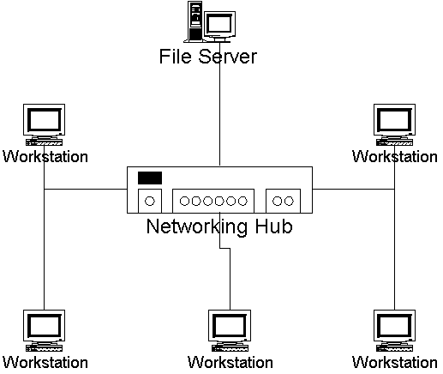
Local Area Network (LAN)
A local area network (LAN) supplies networking capability to a group of computers in close proximity to each other such as in an office building, a school, or a home.

Slide 3
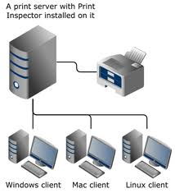
Single Server Network
A computer network in which one centralized, powerful computer (called the server) is a hub to which many less powerful personal computers or workstations (called clients) are connected.

Slide 4
Advantages of single server
Centralized files service
Network printing
Login security
Easy installation
Backup
Support
Management

Slide 5
Disadvantages Of Single Server Network
Can have a single point of failure.
Server can get overloaded.
Generally more expensive and difficult to set up initially.

Slide 6
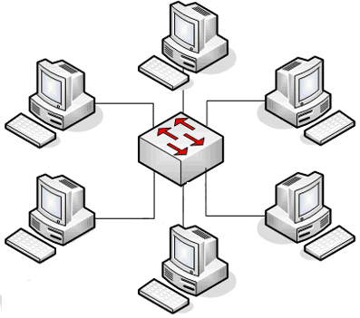
Peer 2 peer Network
A local area network in which network resources are shared among workstations, without a file server. It is a communication model in which each party has the same capabilities and either party can initiate a communication session.

Slide 7
Advantages Of Peer-To-Peer Network
File sharing
Printer sharing
E mail
Tight budgets
Easy installation

Slide 8
Disadvantages of peer to peer network
Security
Backup
Organizing of data
simple administration
Internet/ WAN access

Slide 9
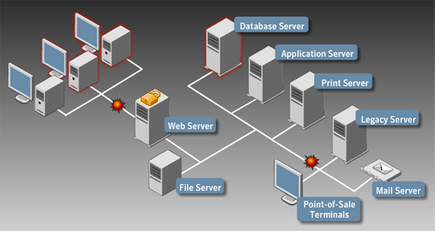
MultiServer Network
In larger networks (50 to 250 users) we have multiple servers on different geographical locations according to the size of the network.

Slide 10
Advantages of Multiserver Network
Centralized file services
Network printing
Workflow and groupware
Login security
Internet/WAN access

Slide 11
Disadvantages of Multiserver Network
Tight budgets
Easy installation
Organizing data
Simple administration

Slide 12
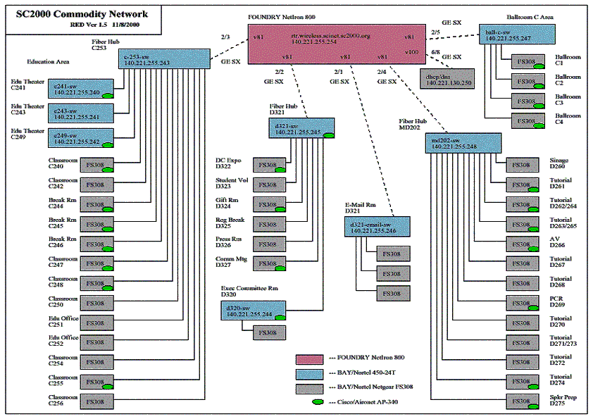
Multiserver High-Speed Backbone Network
This server is applicable when we have 250 to 1000 clients. These clients spread over a large area. So we require both distribute network and a lot of servers. Network of this size will be connected with high speed backbone that runs between servers.

Slide 13
Advantages of Multiserver High-Speed Backbone Network
Centralized file services
Network printing
Workflow and groupware
Login security

Slide 14
Disadvantages of Multiserver High-Speed Backbone Network
Tight budgets
Easy installation
Organization data
speed

Slide 15
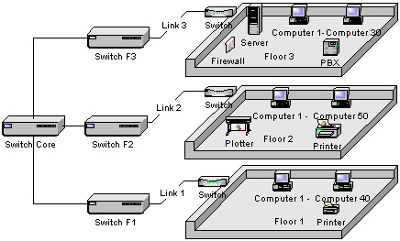
Enterprise Network
For 1000+ users we have enterprise network. In this network we break down the network into multiple connected networks and split along some natural boundary.

Slide 16
Advantages of Enterprise Network
Network printing
Workflow and groupware
Login security
Client server database

Slide 17
Disadvantages of Enterprise Network
Tight budgets
Easy installation
Centralized file service
Organizing data
speed

Slide 18
What software are you using?
Software and files are the data that flows over a network, so knowing what type of software is in use will give you a good estimate of how much data per client will travels the network.

Slide 19
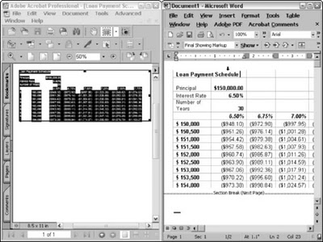
Word processor and spreadsheets
Word processor and spreadsheets programs generate very little in terms of network traffic because they are typically loaded once, their data is edit for sometimes, and then the programs and data are saved.

Slide 20
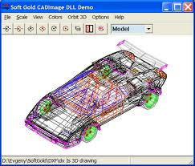
Graphics and CAD(Computer Aided Design)
Graphics and CAD applications tend to place a heavier load on the network than spreadsheet and word processor documents. This is because they are larger and take longer load, which can slow performance of the network for other users. They slow the network when they are loading, but they don’t cause a continuous load on the network.

Slide 21
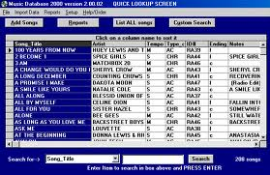
Database software
We made very little number of changes in the database and these databases are uploaded to the file server and very little information is stored in the client computers. So database do not make load on the network until a large number of users is working on the network.

Slide 22
What software you will use?
E-mail
Internet services
Groupware
Video teleconferencing

Slide 23
E-mail
E-mail replaces the inter office memo with a faster, more reliable, and less expensive form of written communication. It is ver easy to use and it offers an immediacy which is not available with postal mail.

Slide 24
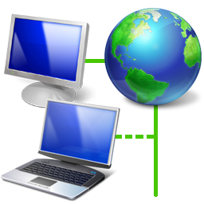
Internet services
The global internet is a simply a vast computer network. Many businesses, schools, and govt agencies have banded together to connect their proprietary internal network using a common set of protocols. Internet services extends many of the benefits of internal networking to include the entire networked world.

Slide 25
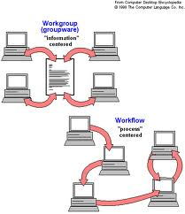
Groupware
In groupware information is passed around the working teams automatically. It is an extension of simple file and e-mail service that provides an extra layer to an organization and process control to organizational data. It is designed to get information where it is needed in a timely manner inside an organization, without relying on people to forward it.

Slide 26
Video Teleconferencing
Digital cameras are becoming more affordable and available. Users can transmit and receive real time video between any to computers connected on a high speed network.

Slide 27
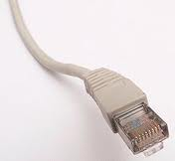
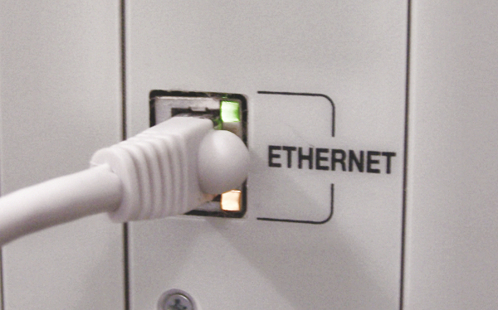
Network technologies
Ethernet
The number of computers connected together to form a local area network. An Ethernet LAN typically uses coaxial cable or special grades of twisted pair wires. Ethernet is also used in wireless LANs. The most commonly installed Ethernet systems are called 10BASE-T and provide transmission speeds up to 10 Mbps.

Slide 28
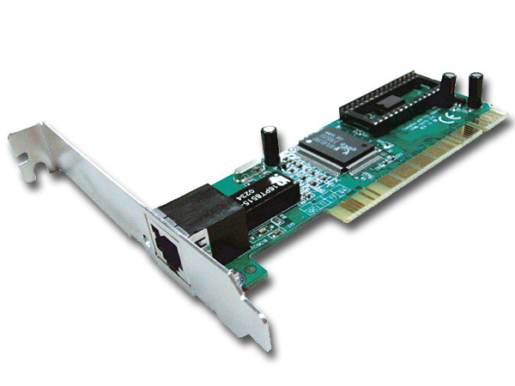
Network technologies
Fast Ethernet
Fast Ethernet or 100BASE-T provides transmission speeds up to 100 megabits per second and is typically used for LAN backbone systems, supporting workstations with 10BASE-T cards.

Slide 29
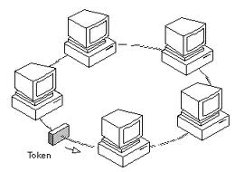
Network technologies
Token ring
Token ring local area network (LAN) technology is a local area network protocol which resides at the data link layer (DLL) of the OSI model. It uses a special three-byte frame called a token that travels around the ring. Token-possession grants the possessor permission to transmit on the medium. Token ring frames travel completely around the loop.

Slide 30
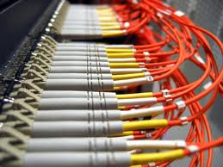
Network technologies
Fiber channel
Fiber Channel, or FC, is a gigabit-speed network technology. It is very expensive and operates at very speed & in very large networks.

Slide 31
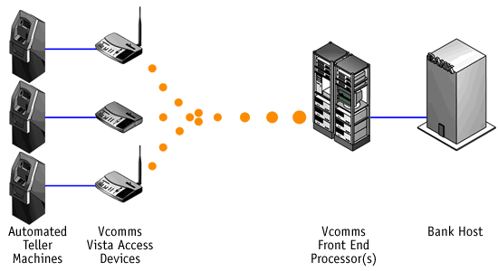
Network technologies
ATM
ATM is being used with much success as a high speed backbone. ATM provide direct connection between private networks and public telephone networks for very high speed success to the internet.

Slide 32
Physical cables
There are different types of physical cables that are used to connect the computers together. In next coming slides we will study the different types of physical cables.

Slide 33
Shielded twisted pair cable

Slide 34
Unshielded twisted pair cable

Slide 35
Coaxal

Slide 36
Fiber

Slide 37
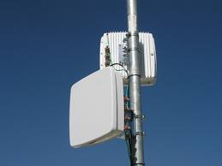
Wireless Radio
Wireless radio network refers to any type of computer network that is not connected by cables of any kind. It is a method by which homes, telecommunications networks and enterprise (business) installations avoid the costly process of introducing cables into a building

Slide 38
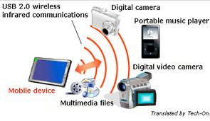
Wireless infrared
Infrared technology allows computing devices to communicate via short-range wireless signals. With infrared, computers can transfer files and other digital data bidirectional. The infrared transmission technology used in computers is similar to that used in consumer product remote control units.

